Slide 1
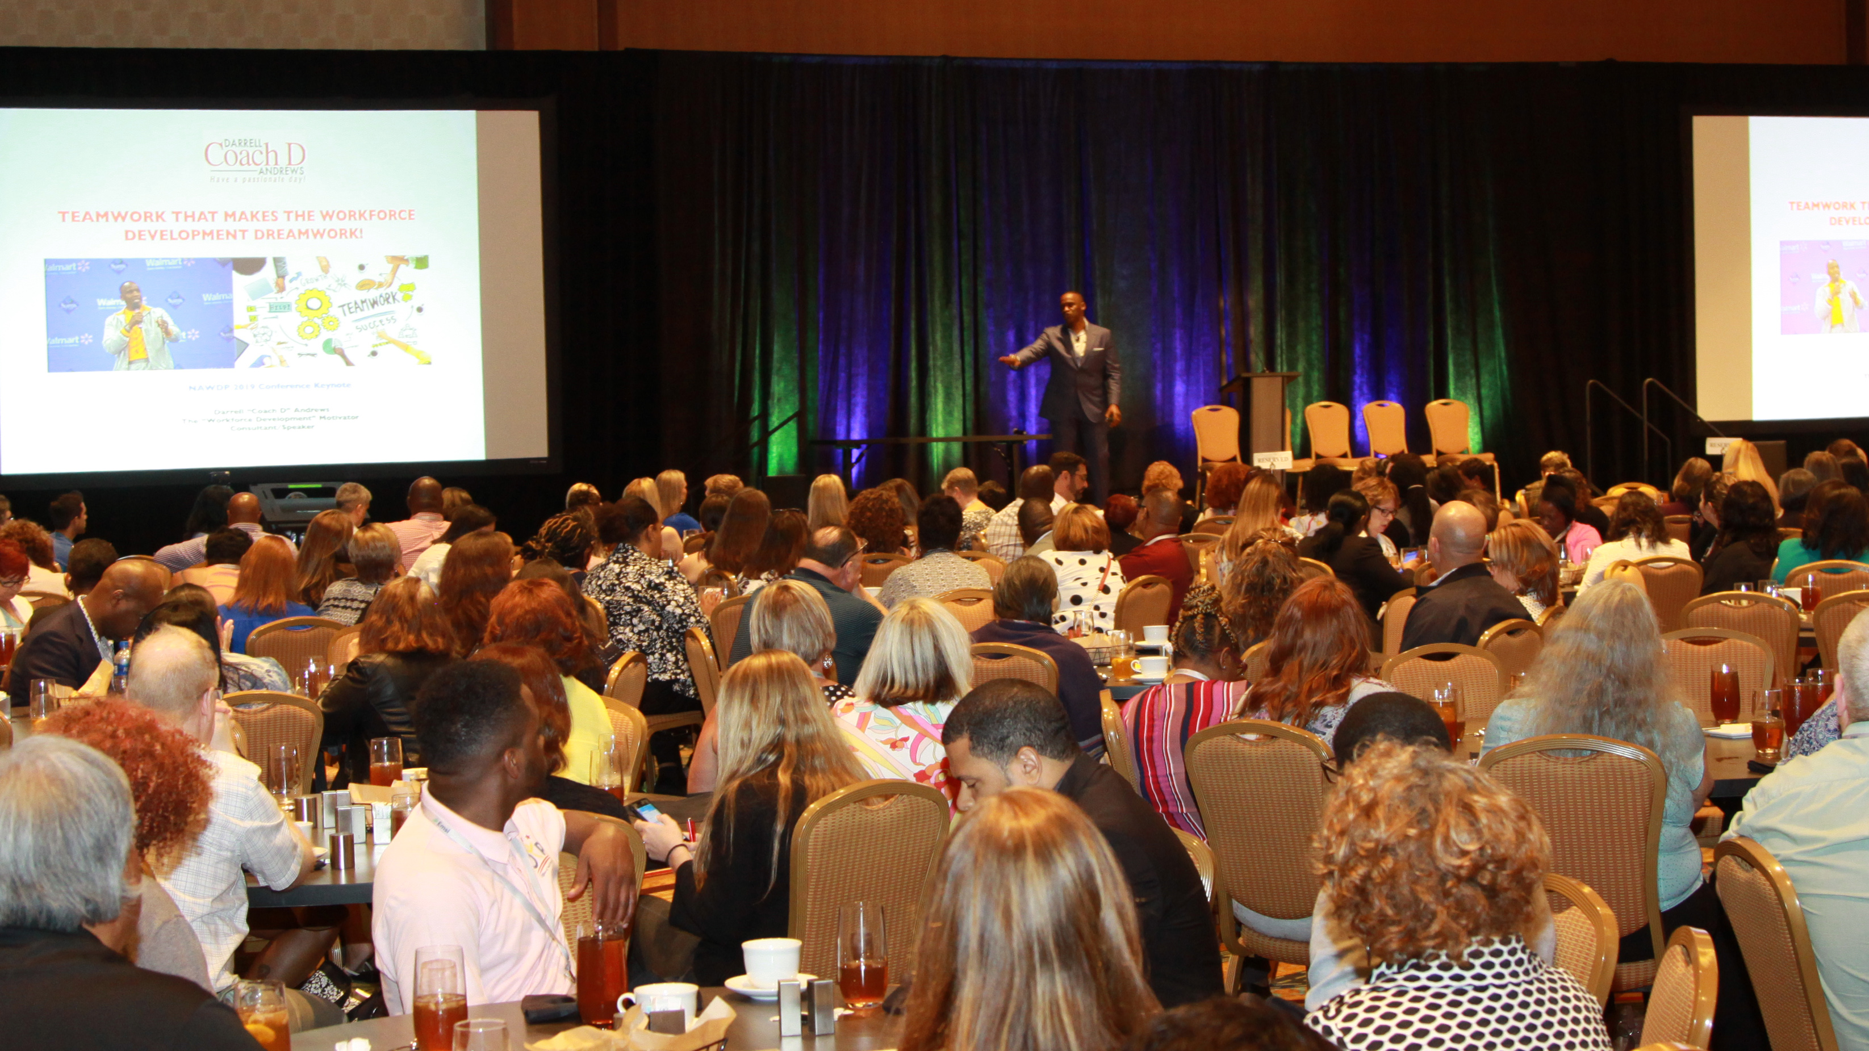
Bounce Forward! With Strategies For Workforce Development Motivation! Delaware Convening
Darrell “Coach D” Andrews-Delaware Workforce Development Consultant/Motivator

Slide 2
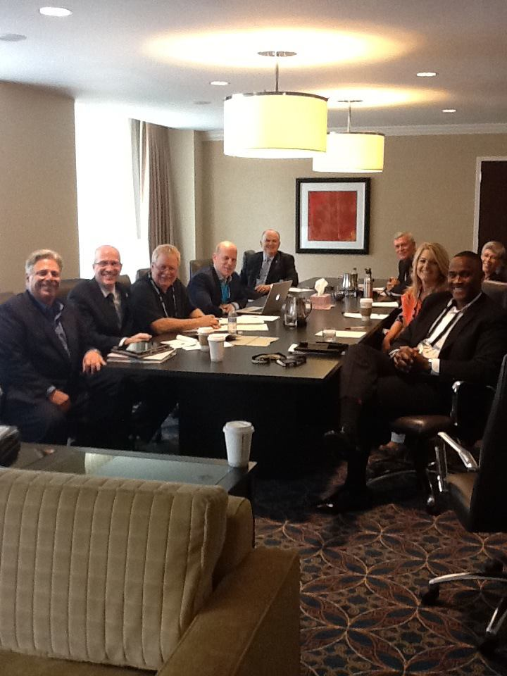
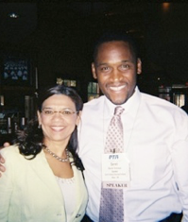
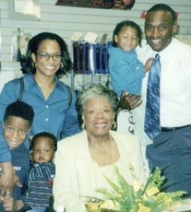
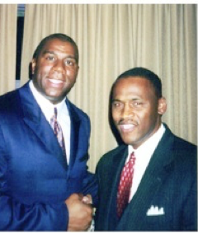
You are a generational transformation expert!

Slide 3
As a result of WD assistance, we have gone from a nationally acclaimed WIA youth provider in DE, to an internationally recognized WD Consulting firm!

Slide 4
Once your mindset changes on the inside, everything changes on the outside! Today, just like an athlete in training, I want you to bounce forward when obstacles arise! Coach D

Slide 5
Why Workforce Development Motivation?
Workforce Development teams, As A Result of The Pandemic, struggle with compassion fatigue.
It takes a balancing act to manage personal emotions, family emotions and the emotions of our clients.
Our personal tanks are often empty. We need to fill them up!
You cannot motivate others, if you yourself are not motivated!

Slide 6
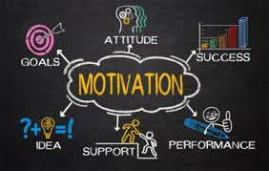
Quote
Success is not final, failure is not fatal. It is the courage to continue that counts!
Winston Churchill

Slide 7
WD Motivation “Bounce Forward” Framework
Motivation
Mindset
Battling Compassion Fatigue
Emotional Intelligence
Self-Care

Slide 8
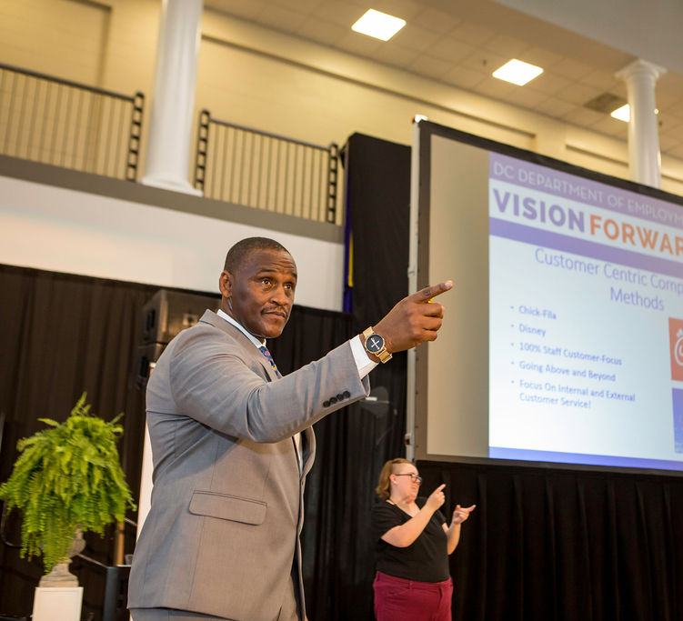
BF1-Mindset (Of Motivation)
The mindset of motivation suggest that we are driven by potential-not problems!
Darrell “Coach D” Andrews

Slide 9
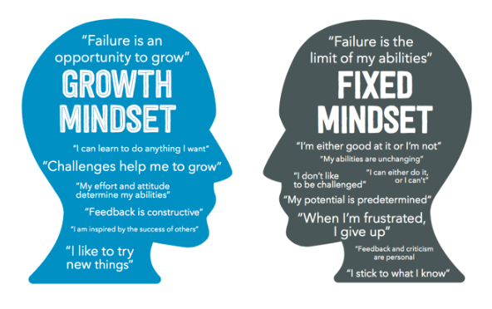
Growth Mindset In WD
We collectively view the vision of the organization as our daily motivation.
Focusing our mindset on vision forces us to see the potential in each other and our clients.
To accomplish this goal-we need to reframe situations on an on-going basis.

Slide 10
BF2-Compassion Fatigue
Compassion fatigue is a type of stress that involves “physical and emotional depletion” as a result of “caring for someone in significant emotional or physical distress.”
People experiencing compassion fatigue have the potential to display a lack of empathy or indifference toward the person they're caring for.

Slide 11
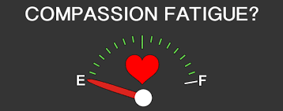
Why?
We often focus on the clients well being more than our own. As a result, end up depleted.

Slide 12
Strategies
1. SET EMOTIONAL BOUNDARIES
2. JOURNAL AND RECORD WINS
2. IDENTIFY WORKPLACE STRATEGIEs Such As:
Support groups and open discussions about compassion fatigue in the workplace
Regular breaks
Routine check-ins
Mental health days
Onsite counseling
Relaxation rooms, massage, meditation classes, etc.
.

Slide 13
BF3-Emotional Intelligence
My response, is my responsibility!
Pierre Campbell
Author
“Simple Intelligence”
Encouraging Attendees To Enjoy Life At My 2019 NAWDP Keynote!

Slide 14
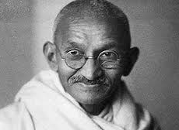
Quote
Keep your thoughts positive because your thoughts become your words.
Keep your words positive, because your words become your behavior.
Keep your behavior positive because your behavior becomes your habits.
Keep your habits positive because your habits become your values.
Keep your values positive because your values become your destiny.
Mahatma Gandhi

Slide 15
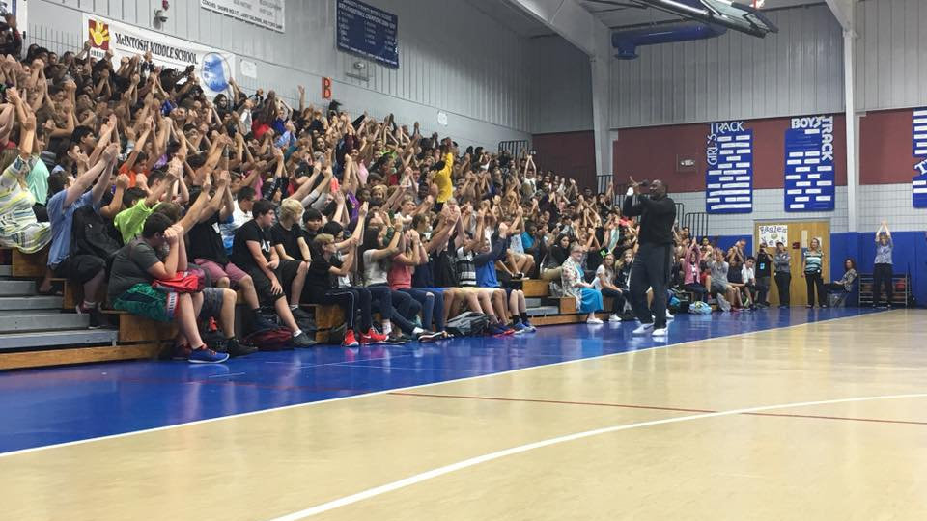
Quote
I have come to the realization that true strength is the ability to take one’s emotional intellect and use it to take control over situations and circumstances!
Coach D

Slide 16
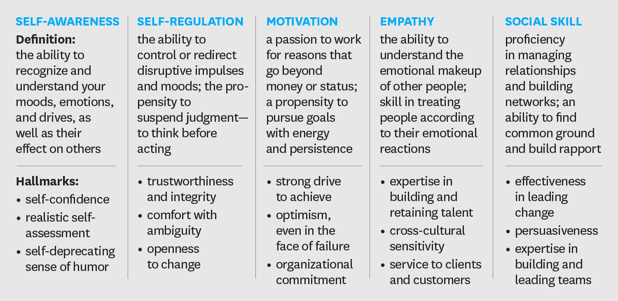
5 Components of EI at Work

Slide 17
BF4-Self-Care!
If there is anyone on the planet that should love you-it should be the person you see in the mirror!
Darrell “Coach D” Andrews

Slide 18
Enjoy Your Life!
Eat Right and Exercise-(It helps to increase white blood cell counts and endorphins-which help to fight disease and infection.)
Enhance Your Knowledge-Analyze best practices in your area of expertise. This builds self-confidence!
Enjoy Your Family!-WD Professionals are struggling with this due to the pandemic. Take the time to find enjoyable things to do together!

Slide 19
Don’t go where the path may lead, instead; go where there is no path, and leave a trail Ralph Waldo Emerson

Slide 20
Darrell “Coach D” Andrews and Associates!
Workforce and VR Professional Development. (Teamwork, Client Motivation, Core Values, Self-Care.)
Racial Equity Consulting and DEI Training.
Youth Career Motivation Events.
Success In The Workplace Client Events (Job Readiness Motivation.)
www.coachdspeaks.com

