Slide 1
Helping the Helpers: How Two Organizations Came Together to Support Youth Presented by: Delaware Guidance Services and Delaware Futures

Slide 2
Presenters
DGS:
Shana Powell, LPCMH Specialized Clinical Services
Katherine Judge, MSW School-Based Therapist
Stephanie Proctor, MSW Family-Based Supervisor
Delaware Futures:
Lori Pritchett, M.Ed., Class Advisor - Sussex County Site
DaRon Smith, Delaware Futures Alum, Class Advisor - New Castle County Site

Slide 3
DGS Clinical Services
24 Hour Youth Crisis​
Family Based Mental Health​
Outpatient Therapeutic Family Support​
Outpatient Services​
Community Based Services
1
2
3
5
4

Slide 4
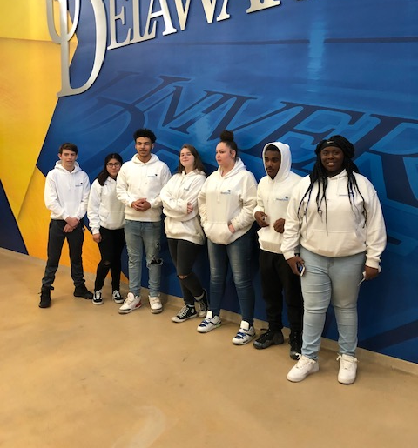
Delaware Futures provides academic, social-motivational support, and cultural enrichment that empowers high school students to recognize and fulfill their unrealized potential and become matriculated college students.

Slide 5
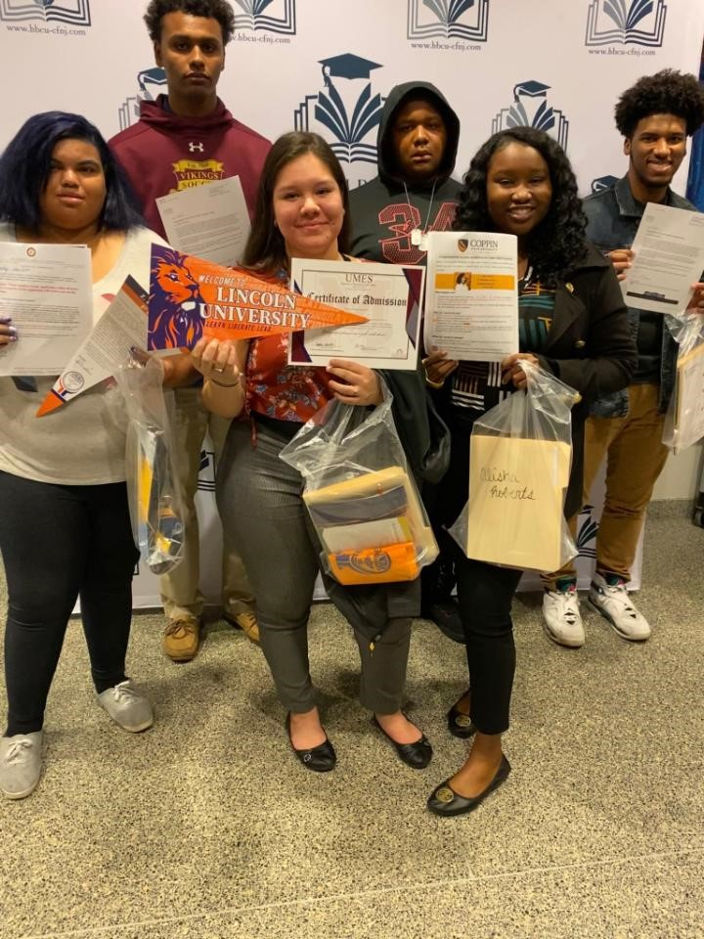
Delaware Futures helps students graduate from high school and prepare for college, post-secondary training, and careers.
-Academic enrichment, tutoring and SAT prep
-Group meetings/peer mentoring
-Leadership development
-One-on-one advisories
-Career exploration/job shadowing
-Paid internship experiences
-Cultural enrichment
-Financial literacy & FAFSA completion
-College Tours
-Application and matriculation support
Success stories/testimonials

Slide 6
Delaware Futures and Delaware Guidance Services Relationship
DGS designed a customized trauma training series as professional development for Delaware Futures
Trauma training for Delaware Futures board, staff & volunteers 2019
Group sessions for staff and students started with onset of COVID crisis in 2020
Group sessions and resilience strategies series – 2021/ongoing

Slide 7
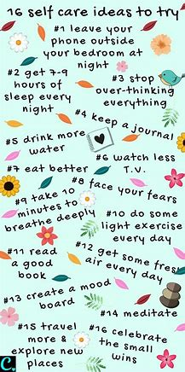
Session Goals
Provide Support
Identify Stressors
Validate Challenges
Teach Strategies
Notes:
KJ

Slide 8
Session Topics
Impacts
Emotional Effects
Social/Racial Injustice
Self-Care

Slide 9
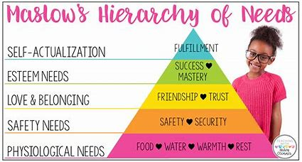
Challenges
Participation
Engagement
Discomfort
Notes:
KJ

Slide 10
Observations
Anxiety
Depression
Overwhelm
Need for systems
of support
Notes:
Anxiety
Depression
Overwhelm
Validation
Support System
Practicing self care

Slide 11
Notes:
What it is
Impact
Warning Signs
What to do

Slide 12
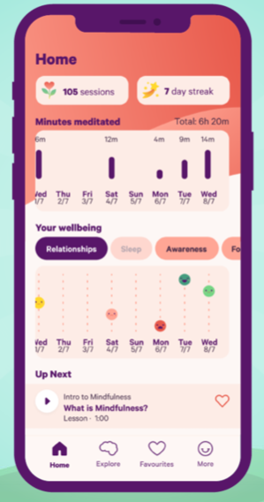
Resources
Smiling Mind App
Self Care Assessment
SMART Goals Map
DGS Crisis Services
Notes:
Smiling Minds:Quick mindfulness and meditation exercises- can filter by age, topic, and time
Used at either the beginning or the end of sessions
Self-Care Assessment
Can be found on TherapistAid
Allows you to have the chance to reflect on your self care in different aspects- Physically, Socially, Emotionally,

Slide 13
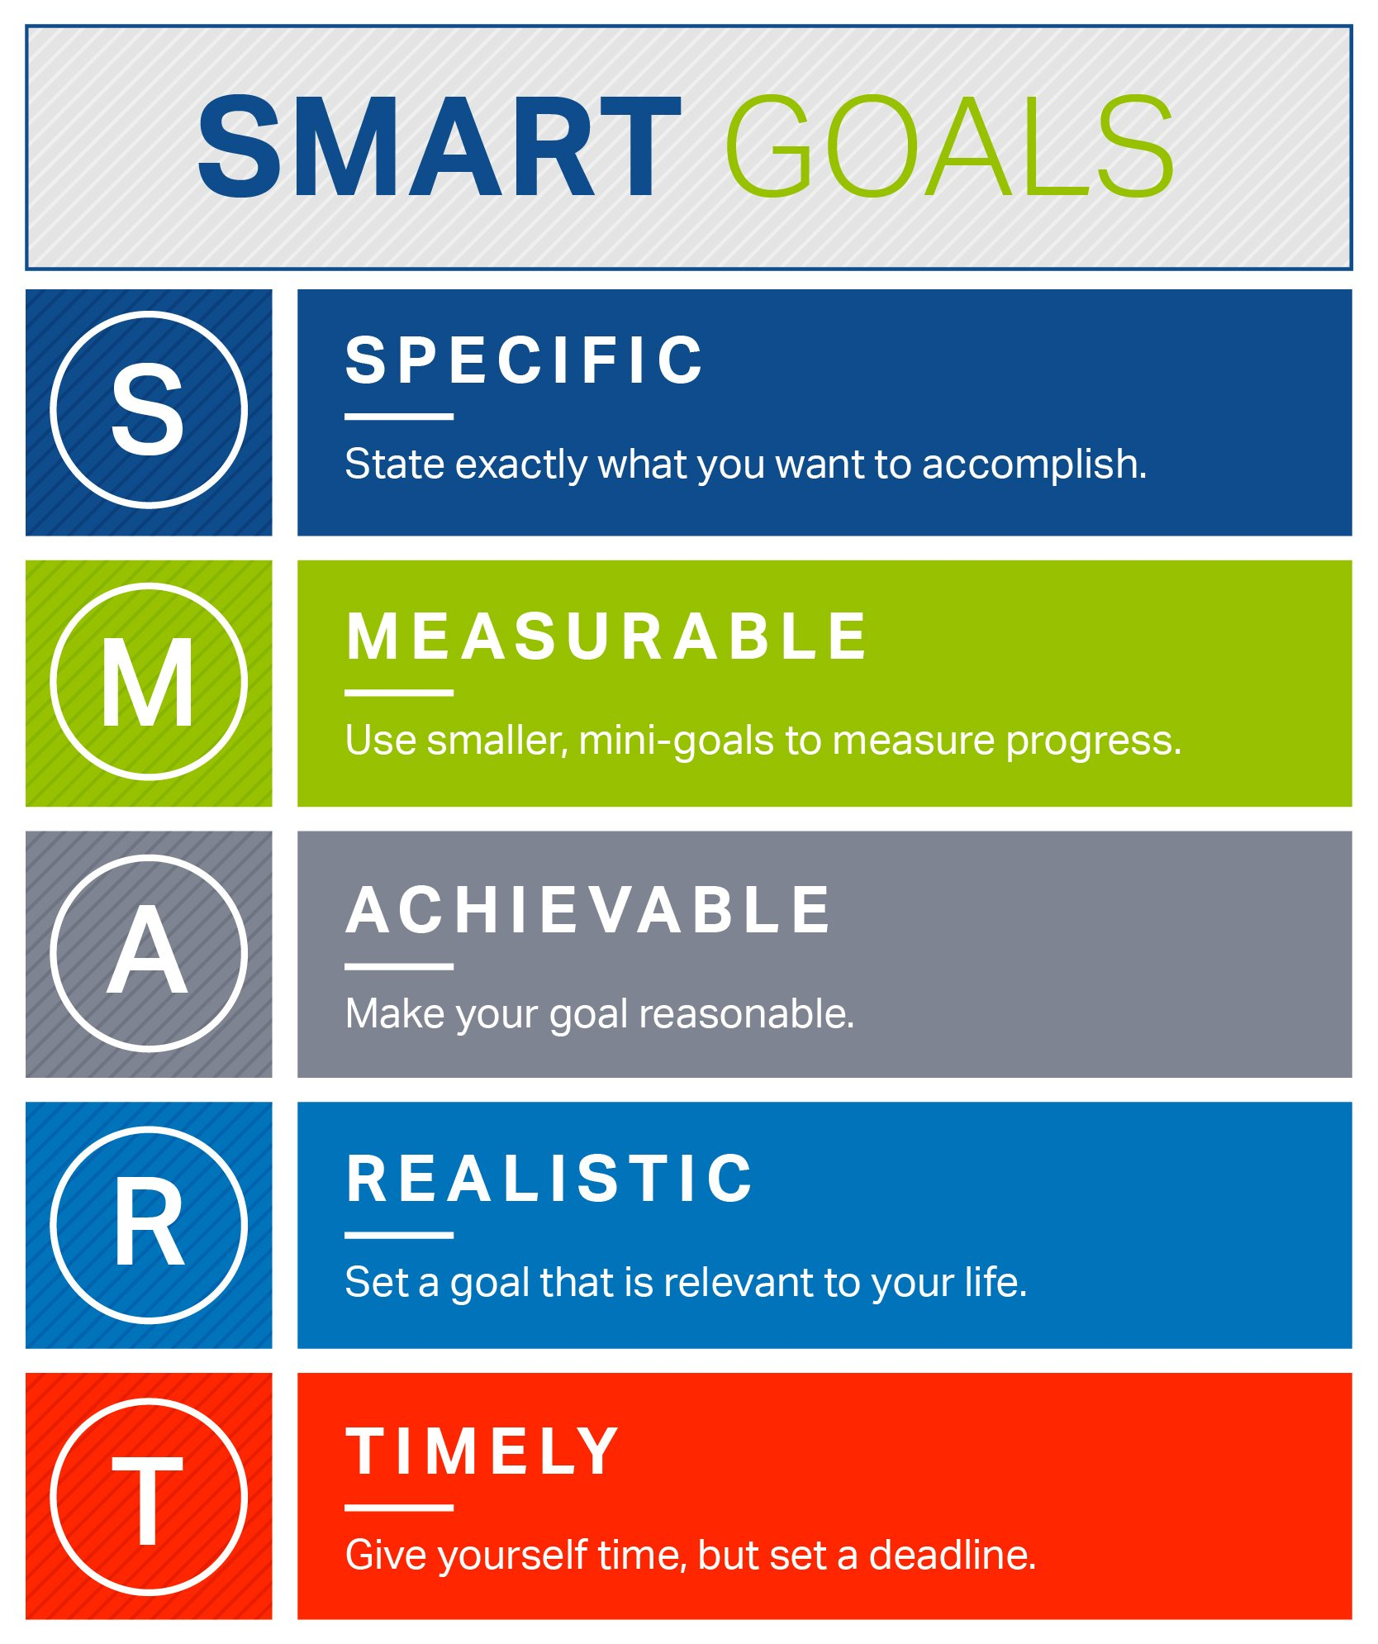

Slide 14
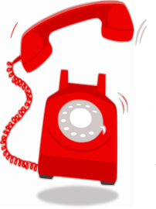
DGS Mobile Response
Call Center transfers appropriate county to dispatch as necessary
Clinician follow-up and linkage to outpatient services
Crisis Occurs, Parent/Provider Call Hotline/ Call Center
Dispatch clinician for youth assessment
Clinical assessment, recommendation is made
MRSS Crisis Hotline: 1-800-969-4357

Slide 15
Suggestions/ Recommendations (SP)
Smiling Mind - Mindful Mindset (Day starter)
Smiling Mind - Gratitude and Joy
Videos of Beginner Yoga Exercises With Adrienne

Slide 16
Questions and Contacts
Shana Powell, LPCMH
Delaware Guidance Services
Spowell@delawareguidance.org
Dina R. Melchiorre, Executive Director
Delaware Futures
(302) 650-2122

