Slide 1
WELCOME
Welcome & thank you for joining the 6th annual One-Stop System Convening:
“Bouncing Forward”
We’ll get started at 9am

Slide 2
WELCOME
The Convening web page:
https://labor.delaware.gov/wib/onestop/6th-annual-2021-one-stop-system-convening/
It’s also listed 1st in chat.

Slide 3
WELCOME
Just added: a special lunch interview @ 12:45:
“The Personal Impact of Trauma and Criminality” – Saad M. Soliman, Reentry Subject Matter Expert, Social Entrepreneur
12:15-1:15 is our lunch break, so grab some food and join us at 12:45pm for this special interview

Slide 4
WELCOME
Zoom tools for you to adjust your virtual webinar experience

Slide 5
2021 Convening
This is a webinar platform so your video and audio are not enabled.
Text Hope with any issues
(302-236-6805)

Slide 6
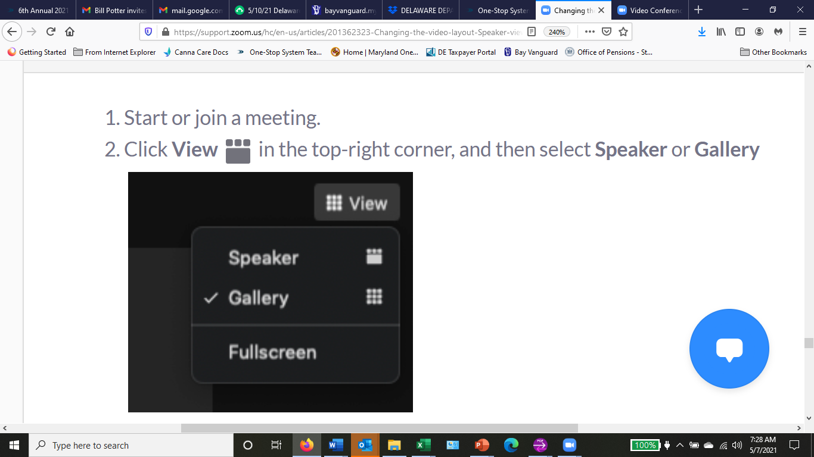
WELCOME
Did you realize you can adjust your view?

Slide 7
WELCOME
Scroll down to the bottom & your
tool bar comes up.

Slide 8
WELCOME
Use “CHAT” for comments, ideas, suggestions.
Use “Q&A” for questions to presenters.

Slide 9
WELCOME
Make sure volume is turned up when recordings are played.
They were made with love and not professional equipment. ☺

Slide 10
WELCOME
Workforce Innovation and
Opportunity Act (WIOA)
&
Delaware’s One-Stop System

Slide 11
WELCOME
WIOA is landmark legislation designed to:
strengthen and improve our nation's public workforce system;
help get Americans, including youth and those with significant barriers to employment, into high-quality jobs and careers; &
help employers hire and retain skilled workers.

Slide 12
WELCOME
Delaware’s One-Stop System
brings together workforce development, educational, and other human resource services
in a seamless customer-focused service delivery network
that enhances access to the programs' services &
improves long-term employment outcomes for individuals receiving assistance.
This Photo by Unknown Author is licensed under CC BY-SA-NC

Slide 14
WELCOME
One-Stop Partners
Division of Employment and Training Adult & Prison Education (DOE)
Division of Vocational rehabilitation Division of Social Services
Division of Unemployment Insurance Division of State Service Centers
Career & Technical Education (DOE) Criminal Justice Council
Division of the Visually Impaired Division of Libraries
Division of Aging Adults with Physical Disabilities Wilmington Job Corps
Office of Financial Empowerment Division of Small Business
Delaware State Housing Authority

Slide 15
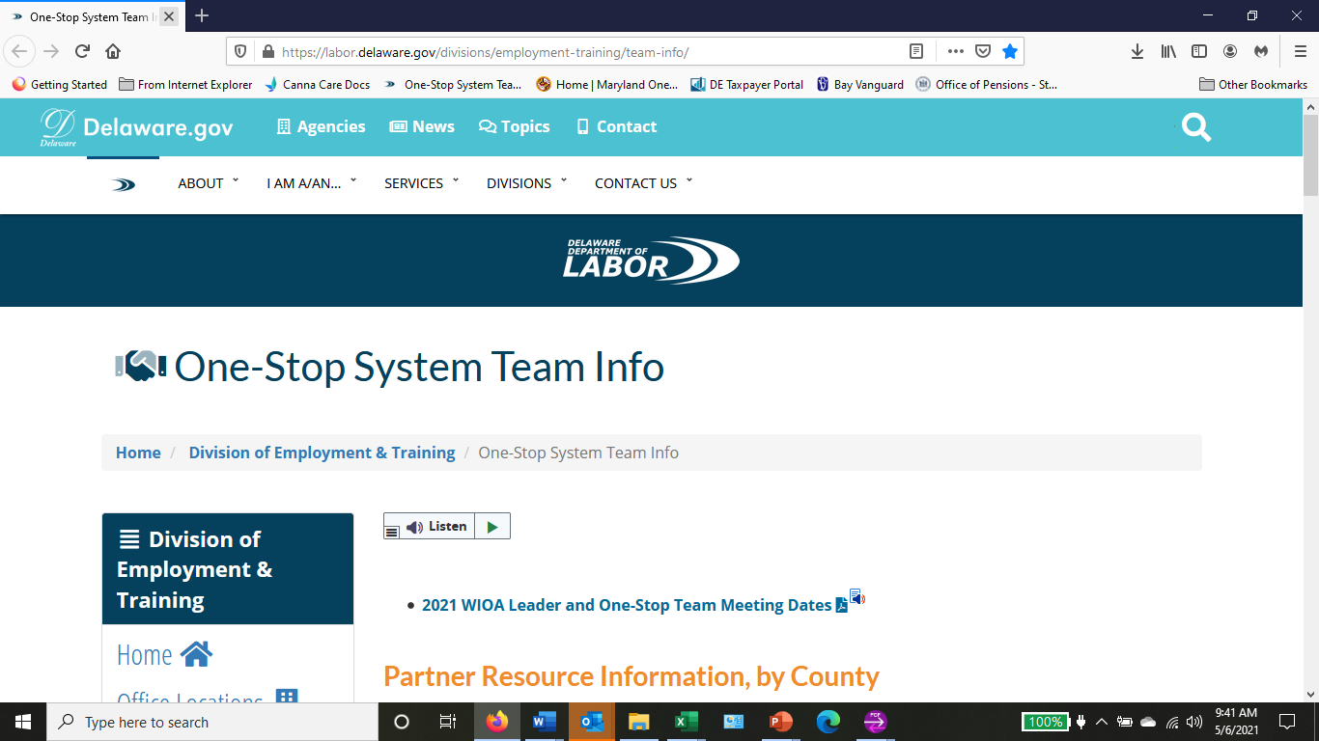
WELCOME
The One-Stop Team Link is full of resources: https://labor.delaware.gov/divisions/employment-training/one-stop-system/
WIOA Orientation PPT for Staff
One-Stop Partner Resources, by County
County One-Stop Team Info
One-Stop System Initiatives & Resources

Slide 16
WELCOME
Hope Ellsworth is the One-Stop Operator…
[302-236-6805; lightquest1@earthlink.net]
Key Duties:
Monthly Facilitation of County One-Stop Teams
Coordination of Annual One-Stop Convening
Monthly Facilitation of WIOA Leadership Team (Leaders from each Partner Program)

Slide 17
WELCOME
Our Team Approach
Teams will develop strategies for continuous improvement:
To key share resources with other program staff
For better coordination of services among programs
To review & reflect on our accomplishments
To identify and address challenges
To share best practices with other staff
To increase networking & communication

Slide 18
WELCOME
Do you take advantage of the Monthly Labor Review?
https://labor.delaware.gov/divisions/oolmi/monthly-labor-review/

Slide 19
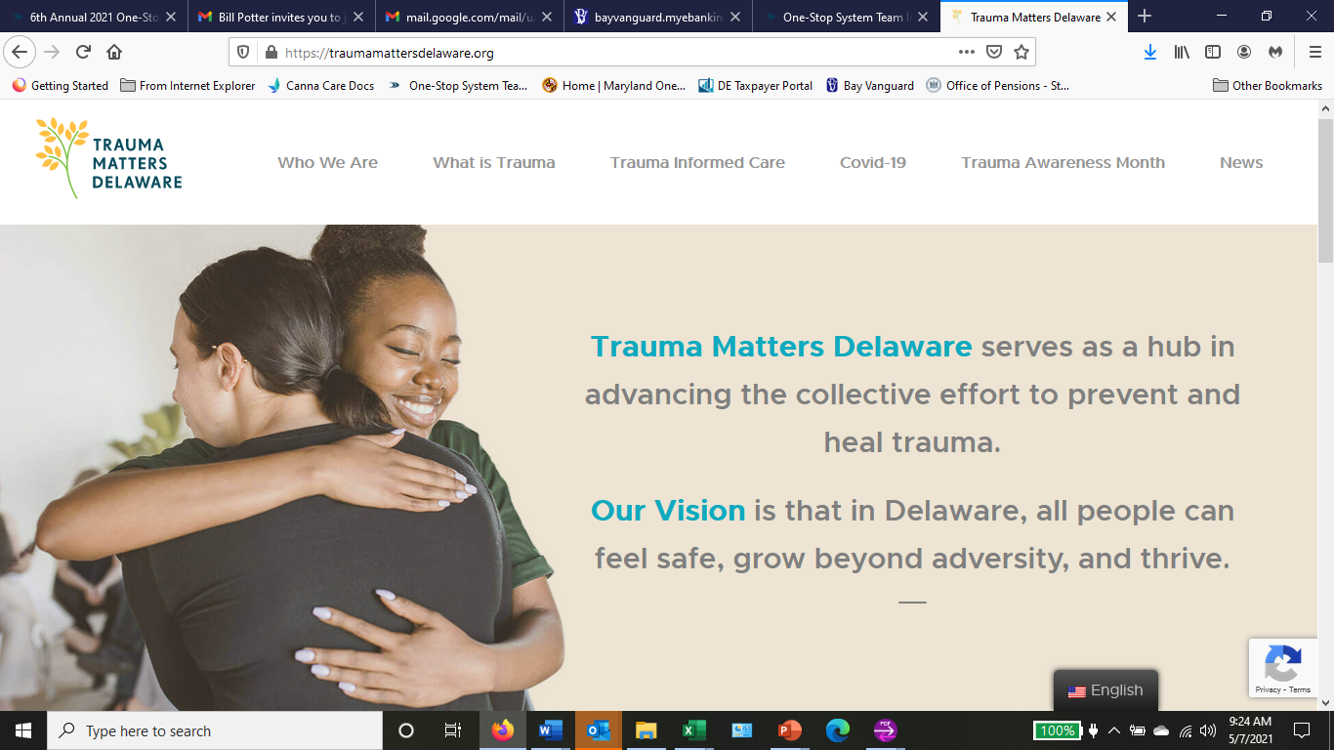
WELCOME
May is Trauma Awareness Month
https://traumamattersdelaware.org/

Slide 20
2021 Convening

