Slide 1

WIOA Staff Orientation
WIOA Staff Orientation
Workforce Innovation &
Opportunity Act (2016)

Slide 2
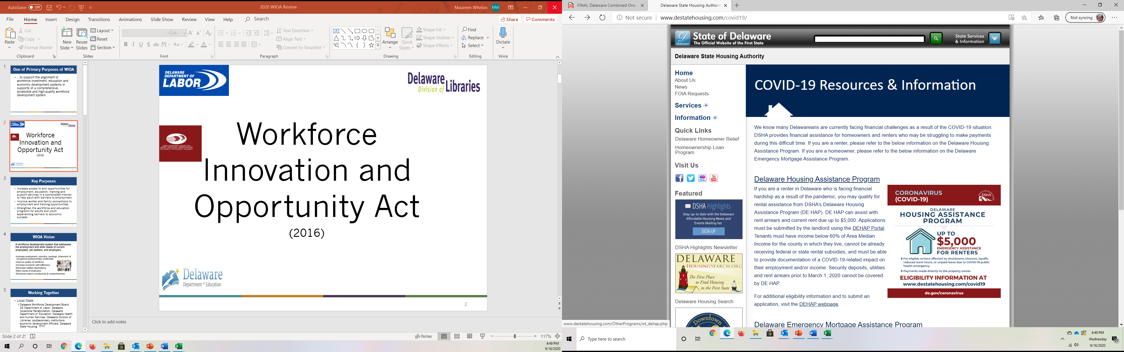
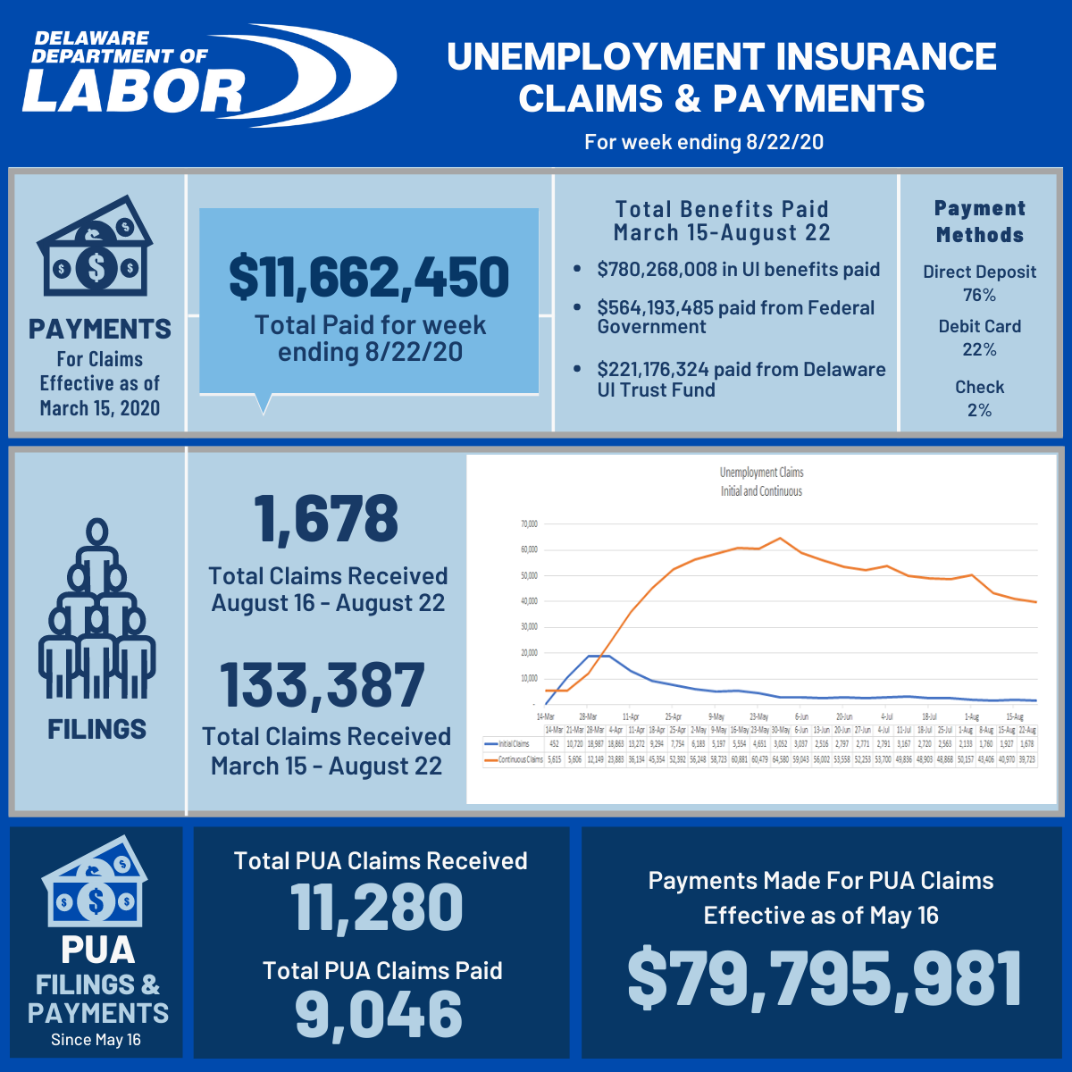

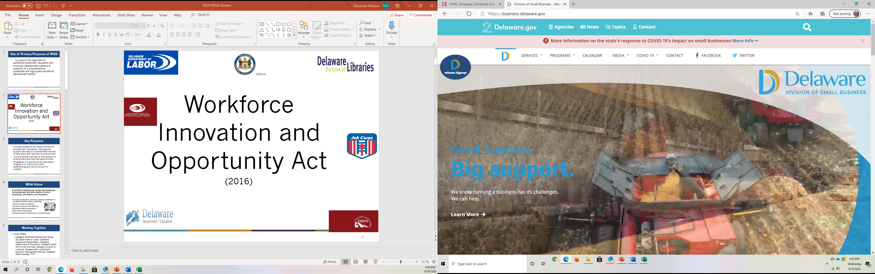


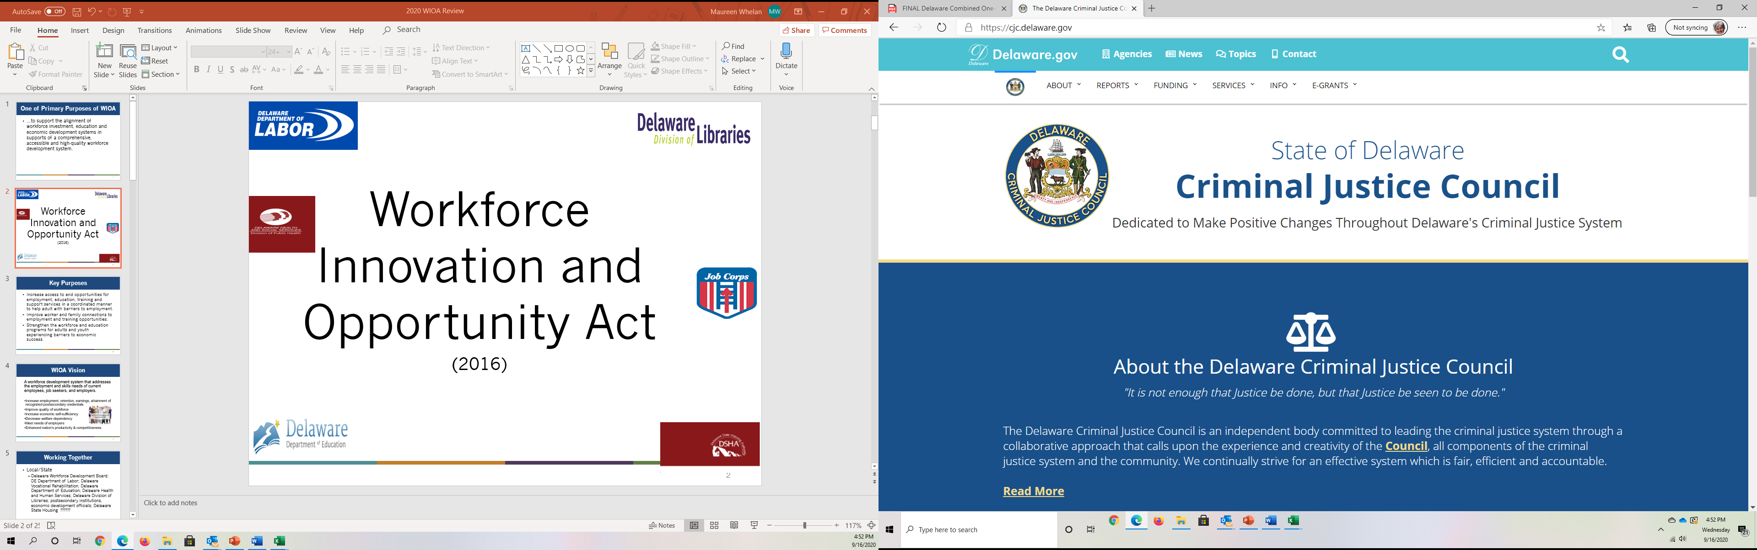

WIOA Partners
Delaware Workforce Development Board
Employment and Training
Unemployment Insurance
Division of Vocational Rehabilitation
DHSS, Division for the Visually Impaired
DHSS, Division of Social Services
DHSS, Division of State Service Centers
Division of Services for Aging and Adults with Physical Disabilities
Adult and Prison Education
Perkins Career and Technical Education

Slide 3

WIOA: Working Together To Support Clients

Slide 4
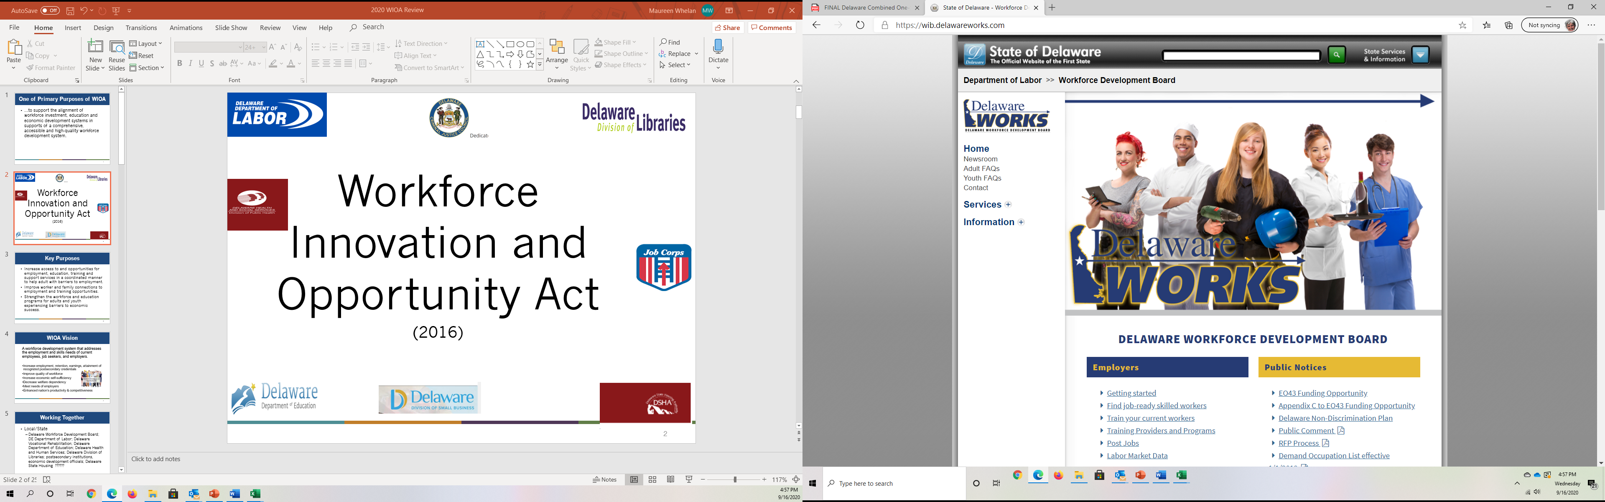
WIOA – What ?
  To create a Delaware workforce development system that addresses the employment and skills needs of job seekers, employers and current employees.

Slide 5
WIOA - WHY?
…to support the alignment of workforce investment, education and economic development systems in supports of a comprehensive, accessible and high-quality workforce development system.

Slide 6





WIOA – WHY?
    Increase employment, retention, earnings, and attainment of recognized postsecondary credentials for Delawareans
    Improve quality of Delaware’s workforce
    Increase Delawareans’ economic self-sufficiency
    Decrease welfare dependency
    Meet needs of Delaware employers
    Enhance Delaware’s productivity & competitiveness

Slide 7

WIOA - How?
Increase access to and opportunities for employment, education, training and support services
Support mutual customers in a coordinated manner to help adults and youth with barriers to employment.
Strengthen the workforce and education programs for adults and youth experiencing barriers to economic success to meet current employer needs!

Slide 8
WIOA Partner Principles
    Program alignment (WIOA Partners)
      Unified strategic planning across partner programs
      Provide needed services to support success of mutual clients
    Increased accountability
      Review common measures for reporting to funding agencies
      Increase transparency through shared reporting
    Enhanced service delivery
      Promote engagement of employers
      Coordinate partner activities to assist clients in:
        gaining employment in in-demand industries
        entering further training and/or education to attain better jobs
      Strengthen partnerships and investments in One-Stop delivery system

Slide 9

WIOA Focus
Displace homemakers
English language learners
Exhausting Temporary Assistance to Needy Families (TANF) benefits within two years
Formerly incarcerated individuals
Homeless individual, homeless children, youth or runaway youth
Long term unemployed
Low income
Migrant and seasonal farm workers
Individuals with disabilities
Single parents
Youth in foster care

Slide 10

WIOA Core Partner Outcomes
Percentage of participants in unsubsidized employment during second quarter after exit
Percentage of participants in unsubsidized employment during fourth quarter after exit
Median earnings of participants employed during second quarter after exit
Percentage of participants who obtain a postsecondary credential or high school diploma who have entered employment within one year after exit or entered a further education or training program leading to a postsecondary credential within one year after exit
Percentage of participants who, during a program year, are in an education or training program that leads to a postsecondary credential or employment and who are achieving measurable skill gains towards a credential or employment
Effectiveness in serving employers

Slide 11
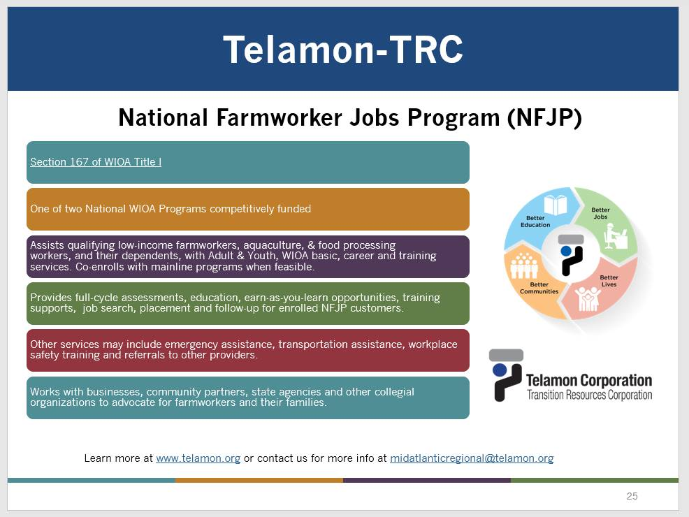
Division of Employment and Training (DET) Services and Programs
Key Elements:
Delaware JobLink NextGen - Delaware’s comprehensive, web-based workforce development system that connects:
  Businesses to qualified talent
  Job Seekers to jobs
  Information on Training opportunities
  Jobseekers with DOL’s One-Stop Partner Services
Career Services - The 4 American Job Centers (AJCs) offer a variety of Labor Exchange employment and training services to jobseekers as well as to employers
  Job Fairs; Job Clubs; Workshops, such as Basic Computer Training, Job Search, and Interview Strategies, Career Planning Workshop; Assessments Tests; Job search and employment assistance
Training Services - The Division of Employment and Training (DET) can help cover the cost of degree, license and certificate programs.

Slide 12
Division of Employment and Training (DET) Services and Programs contd..
DET Programs:
Dislocated Worker Program assists individuals laid off from a job to obtain employment through training and related employment services.
Apprenticeship and Training is a proven method of training involving on-the-job work experience coupled with related instruction.
Veteran's services includes the Disabled Veterans Outreach Program (DVOP) which is an outreach program designed to meet the needs of veterans, especially disabled veterans.
Youth Services assists youth ages 14-24 with removing barriers and becoming credentialed.
State Summer Youth Employment Program is a jobs program that awards grants to qualifying non-profit agencies and organizations for the hiring of Delaware youth during the summer months.
The Trade Act (TAA) assists workers whose employment is adversely affected by imports.
Work Opportunity Tax Credit (WOTC) is a federal tax credit that offers an incentive for private sector businesses to hire individuals from identified targeted groups that have consistently faced significant barriers to employment in Delaware.
Migrant and Seasonal Farmworkers Program includes a variety of services to assist migrant and seasonal farm workers and their families
Senior Community Service Employment Program provides paid, part-time work experience for eligible persons.
Other Programs & Services:
Federal Bonding Program to provide Fidelity Bonds for “at-risk,” hard-to-place job seekers.
Provide Special assistance for those laid off as a result of a plant closing, mass layoff or increased imports
TANF Recipients: Collaborate with approved contractors to deliver E&T services to TANF recipients

Slide 13
Division of Employment and Training (DET) Youth Programs
Employment and Training issues Requests for Proposals each year for Youth Service Providers to assist youth ages 14-24 with removing barriers and becoming credentialed.
  In School Youth – Ages 14-21
    Delaware Futures – Statewide
    Jobs for Delaware Graduates – Statewide
    Pathways to Success – Sussex County
  Out of School Youth – Ages 16 -24
    Food Bank of Delaware – Newark and Milford
    Delaware Tech Owens Campus – Sussex County
    Delaware Tech Terry Campus – Kent County
    The Challenge Program – Wilmington;
    West End Neighborhood House – Wilmington
  Programs are Designed to:
    Improve Educational Achievement:
    Prepare and Succeed in Employment
    Support Youth through program and1 year after exit
    Developing Potential through leadership development and financial literacy

Slide 14




Division of Vocational Rehabilitation (DVR)
Key Customer Services For:
Business
Vocational Rehabilitation assists business with gaining access to one of the largest untapped talents in today’s workforce; people with disabilities. Working with you as your recruiter, we match your needs & job requirements with qualified & skilled candidates.
Services that may be available:
Recruitment
Applicant Prescreening
Staff Training
Retention
Financial Supports
Consulting
Technical Assistance and Support
Vendors
DVR purchases services and maintains contracts with community providers as a part of an RFP process or through open market to meet the service needs of program participants.
Participants
Vocational Rehabilitation is an
“eligibility-based” program.
To receive services, you must:
have a disability that interferes with your ability to find employment and
require services from vocational rehabilitation to become employed.
Services that may be available:
Assessment
Counseling and Guidance
Career Counseling
Physical Restoration
Training​
Job Placement
Follow-up for 90 days
https://labor.delaware.gov/DVR
https://www.facebook.com/DelawareDVR/

Slide 15

Division of Unemployment Insurance
Financial support for eligible workers who become unemployed
Unemployment Insurance
Make the client payments related to the Trade Act
Provide wage and other data
Interface systems with other WIOA Partners as needed

Slide 16
WIOA – Criminal Justice
Delaware Criminal Justice Council
CJC: State Administering Agency – applies and sub awards funds through the Second Chance Act grants. Contact: Valarie Tickle – valarie.tickle@delaware.gov
Reentry Grant Mission: Reduce crime by implementing a seamless plan of appropriate evidence-based services and supervision from time of entry into prison through transition, reintegration and community-based support.
Reentry Grant Goal: Promote safety and increase success rate of individuals released from the Dept. of Correction and reintegrating to the community through: Housing supports; education; training and employment and a continuum of care and support

Slide 17
Delaware Division of Social Services Supports
Employment and Training
Temporary Assistance to Needy Families
Re-entry to Housing Program
TANF & TANF Like Rental and Utility Assistance
$tand By Me
Community Partner Support Unit
Work Opportunities Networks to Develop Employment Readiness (W.O.N.D.E.R. WORKS)

Slide 18
Delaware Division of Social Services
Supplemental Nutrition Assistance Program (SNAP)
SNAP is a Delaware food supplemental program that enables low-income families to buy a variety of food for better nutrition. Food benefits are issued electronically to the household on an Electronic Benefits Transfer (EBT) each month. Participation in TANF is subject to eligibility requirements.
Temporary Assistance for Needy Families (TANF)
TANF is Delaware's main cash assistance program.
The goal of TANF is to give people temporary help until they get a job.
Time on TANF is limited for most people. An individual can get TANF benefits for 36 months, but they must work or participate in work related activities. Participation in TANF is subject to eligibility requirements.
Employment and Training (E&T)
DSS has E&T programs for TANF and SNAP recipients, some recipients have E$T participation requirements. The goal of E&T is to assist participants in gaining skills, training, or work experiences that increase their ability to obtain employment that leads to self-sufficiency.
Other Roles:
DSS develops partnerships and assists partners to increase clients’ access to benefits and services including TANF, General Assistance, SNAP, Purchasing of Care and Medicaid. These partnerships provide advocacy for clients and a collaboration of services and resources to assist Delawareans in need.

Slide 19
Delaware Division of Social Services Continued
DSS Guiding Principles
  Helps partners increase clients’ access to benefits and services including TANF (Temporary Assistance for Needy Families), General Assistance, SNAP Supplemental Nutrition Assistance Program, POC (Purchase of Care) childcare assistance, and Medicaid.
  Trains partners to use the ASSIST online application and screening site to help clients apply for benefits on-site.
  Supports job training and placement programs that help clients lead secure, self-sufficient lives.
  Advocates for partners whose clients need resources the organization doesn’t offer.
Teamwork
Integrity
Diversity
Customer Focus
Community Involvement
Continuous Improvement
Respect

Slide 20

Division of Libraries
Job/Career Services
Visit our LibGuide for our FREE program offering workshops & resources designed to help you be successful.
Schedule a FREE 30 minute phone consultation! An Employment/Career Advisor will call you at the appointed time to discuss any questions you have regarding career and related needs.
Review your resume, cover letter, LinkedIn
Mock Interviews
Online occupational, academic, GED resources
Job coaching & brainstorming sessions
(*due to Covid-19, in-person assistance is limited. Call your library before visiting. Additional in-person services include learning basic computer skills, filling out job applications, and writing a resume.)
Business Services
Through our extensive Partner Network, we
are able to offer assistance for entrepreneurs
in libraries throughout the state.
Find resources in the Business &
Entrepreneurship LibGuide including a link to incorporate online and to Data Axle
Reference Solutions (Reference USA),
a database of businesses to identify potential customers and your competition.
*Visit our guide on Covid19 Business Resources
Schedule a FREE 30 minute phone
consultation with a
Business Advisor in English or Spanish.
Delawarelibraries.org/services

Slide 21
Division of Small Businesses
Small Business. BIG SUPPORT.
Are you a would-be entrepreneur or an experienced business owner? We can provide one on one assistance and counseling to help you succeed.
Navigating government processes
Connecting with resource organizations
Accessing capital
Support for businesses that are:
  Minority owned
  Women owned
  Veteran owned
  Businesses owned by disabled individuals
Contact - Division of Small Business - State of Delaware

Slide 22
Adult and Prison Education
Provide
Provide ABE/GED/High School Diploma instruction at Delaware One Stop Centers, in the community, and in correctional settings
Work
Work with WIOA Partners to align resources that provide adult learners with instruction/training for in-demand jobs and to offer education/training for careers that support family sustaining salaries and opportunities for higher skilled positions
Align
Align Prison Education activities to support re-entering citizens in positive reintegration into their communities through academic, vocational and life skills instruction
Develop
Develop integrated educational and vocational programming that supports entry into and promotion within jobs and careers in the current and future Delaware job market.
Support
Assist Delawareans to expand their opportunities and
transform their futures by upskilling and providing
transferable skills that to better support themselves,
their families and communities.
Adult and Prison Education Resources
For more information, see the Adult and Prison Education Resources website.

Slide 23

Career and Technical Education
Provide | Provide a structured approach for delivering academic and CTE education to youth and adult learners that connects secondary and postsecondary programs.
Align | Align with workforce needs, build partnerships with relevant stakeholders, and create opportunities to scale instructional programs across local education agencies and postsecondary systems.
Include | Include early career and early postsecondary opportunities.
Lead | Lead to a stackable industry recognized credential or certificate which holds value at the professional or postsecondary level.
For more information, see the CTE website.

Slide 24
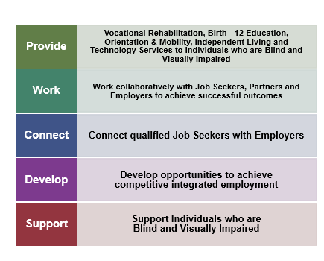

Division for the Visually Impaired
For more information, contact DVI

Slide 25
Delaware State Housing Authority
DSHA is one of only 39 Moving to Work (MTW) agencies across the country.
MTW participants receive specialized case management activities specifically geared to help residents improve employment opportunities, increase budgeting and finance knowledge as well as referral services to assist in overcoming other barriers such as child care, transportation, legal assistance, etc.
For more information:
Delaware State Housing Authority
DSHA’S role in WIOA One-Stop
Share best practices and work collaboratively
Refer residents to programs or activities
Help register residents on JobLink
Provide access to One-Stop Services at our sites

Slide 26
Telamon -TRC

Slide 27
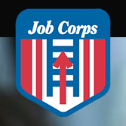
Wilmington Job Corps
Do you know a 16 to 24-year-old who wants to take
next step toward a better future?
Start a career
  Culinary Arts
  Office Administration
  Nursing Assistant
  Facilities
Finish your diploma
Attain your GED®
Job Corps provides meals, basic health care, school supplies, a community full of supporters, academics, career counseling and assistance finding a job.
Contact us at: Job Corps

Slide 28
WIOA Partner Common Responsibilities
Provide access to program or activities through the one stop delivery system
Share information and schedule of services with WIOA partners
Use Delaware JobLink when clients are job ready
Share best practices
Work jointly to provide services that benefit mutual customers
Serve as consultants on grant proposals
Explore and apply for additional funding

Slide 29


WIOA
Please complete this survey to let us know what you think.

