Slide 1
Welcome! Meeting will begin in a moment.
For optimal viewing, click View Options at the top of the screen and select Fit to Screen.
You can manage your audio by clicking audio settings at the top corner of your screen.
All attendees will be muted.
By default, the sound will broadcast through your computer, so please make sure your speakers are turned on or your headphones are plugged in.
If you do not have sound capabilities on your computer or prefer to listen by phone, call either of the following numbers:
646-558-8656 or 669-900-6833
Meeting ID: 367-715-571
Training materials, such as the PowerPoint file for this presentation, will be available on the WINTAC website.
Notes:
Shannon

Slide 2
Welcome
For optimal viewing, click View Options at the top of the screen and select Fit to Screen.
You can manage your audio by clicking audio settings at the top corner of your screen.
All attendees will be muted.
By default, the sound will be broadcast through your computer, so please make sure your speakers are turned on or your headphones are plugged in.
If you do not have sound capabilities on your computer or prefer to listen by phone, call either of the following numbers:
646-558-8656 or 669-900-6833
Meeting ID: 367-715-571
Notes:
Shannon

Slide 3
During This Meeting
Real-time captioning is provided during this training. The captions can be viewed by clicking the Closed Caption button, which appears at the top of the screen. To expand and scroll through the captioning history, click the upper right corner of the captioning box.
If you experience any technical difficulties during the training, please use Chat to send a message, and we will do our best to assist you.
For Q&A: Please use Chat to submit any questions you have during the training and we will direct the questions accordingly.
Training materials, such as the PowerPoint file for this presentation, will be available on the WINTAC website.
Notes:
Shannon

Slide 4
Please Note
To enter the Full Screen view, click the Full Screen button found in the upper right corner of the screen. This allows the presentation area to fill your screen while “watching” a presentation.
Note: The Full Screen view will hide the Chat pane. Click Chat at the bottom of the screen to re-open chat in a pop-out window. To exit out of Full Screen, click the Full Screen button again.
This training is being recorded, and the archive and all materials will be available on the WINTAC website.
Notes:
Shannon

Slide 5

Assessing WIOA Service Integration The Integration Continuum
Workforce Innovation Technical Assistance Center
(WINTAC)
September 2018
Notes:
Shannon

Slide 6



Presenters
Lou Adams
Training and TA Manager, WINTAC
ladams@ndi-inc.org
Doug Keast
Project Director, WINTAC dkeast@ndi-inc.org
Meera Adya, PhD
Senior Director of Research and Evaluation, WINTAC
madya@syr.edu
Notes:
Shannon

Slide 7
Learning Objectives
Develop a greater understanding of integrating services between Vocational Rehabilitation and other Core Programs in the American Job Center - Workforce System.
Understand the basic processes and examples of service and system integration.
Understand the concept of an Integration Continuum and be able to define each stage: Isolation, Communication, Coordination, Collaboration and Integration.
Recognize the differences in each stage using a common problem statement and the resultant approach and impact.
Understand the online Integration Self-Assessment and how they can impact the movement towards integration.
Identify how integrative service goals can be created by partners using the Group Assessment and Planning Process
Notes:
Shannon

Slide 8
What is Service Integration?
Service integration involves:
A combination of strategies to align and simplify access to client services and supports with the goal of providing the best experience possible.
Implementation of a distinctive mix of partner agencies, strategies and processes based on the resources available, the needs of the clients served and WIOA requirements.
The introduction of innovative practices into Core Programs’ service systems which have a positive impact on:
Service delivery policies and procedures
Management information systems
Performance management systems
Notes:
Doug

Slide 9
Benefits of Integrated Service Delivery
Economize scarce resources
Enhance job seeker/claimant/customer outcomes
Provide effective services to employers
Boost data availability
Improve performance accountability
Notes:
Doug

Slide 10
The Concept of Continuum
Not every system or process can change at the same time.
Core partners will be at different stages of the continuum at different times.
It is important to recognize the stages of the interaction between the core partners so you can determine where you are at present, and develop plans to move to the next stage.
Some plan elements will be easier to implement than others.
Core partners may not be able to move at the same pace.
Notes:
Doug

Slide 11
Self-Assessment
How does self-assessment help us?
Provides an environmental scan
Identifies which partnerships might be strategically strengthened
Meets agency operational objectives
Meets customer objectives
Establishes a basis for evaluating agency progress
Notes:
Doug

Slide 12
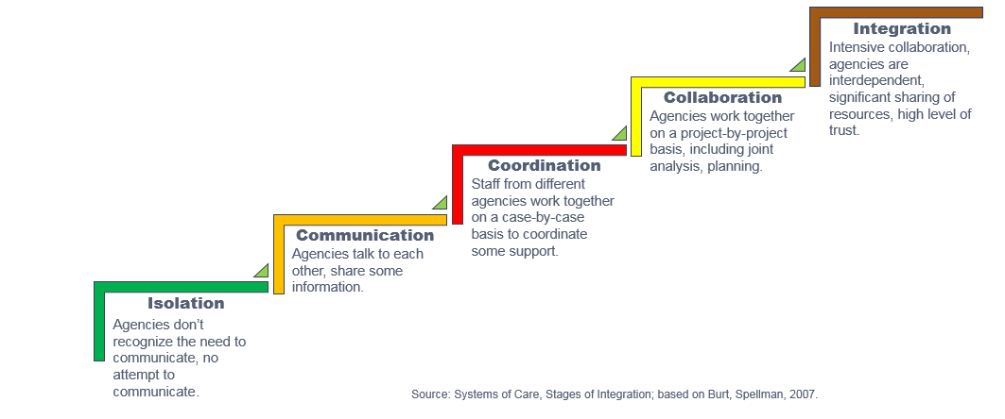
Are We Collaborating? Levels of Collaboration
Created by WINTAC based on Stages of Integration; Burt and Spellman 2007
Notes:
Lou

Slide 13
Isolation
Each agency and program has its own separate career service options.
Agencies and programs do not regularly inform partners of those services.
Each separate agency and program promotes services separately to community.
Notes:
Doug

Slide 14
Communication
Core agencies talk to each other, but they have no planned or required contact.
Contact is intermittent. Some information is shared, but no formal information or data sharing plan exists.
Notes:
Doug

Slide 15
Coordination
Core partners work together at all levels (from management to direct service) to align services, but there is no formal structure to their interaction.
It is done on a case-by-case basis.
Notes:
Doug

Slide 16
Collaboration
Core agencies agree to work together for mutual benefit.
The relationship is based on consistent communication and coordination.
Partners agree they can best achieve goals by working together and using the strengths and expertise of each partner to accomplish common goals.
Notes:
Doug

Slide 17
Integration
Core agencies agree to work together to achieve common goals and create an organizational structure to share information, data and resources to accomplish mutually agreed upon outcomes as an integrated system.
Notes:
Doug

Slide 18
Integration Continuum Self-Assessment
This online self-assessment looks at your level of connectivity to other American Job Center (AJC) – One-Stop Partners.
There is no right or wrong level except Isolation, the desire is to do what best serves your customers and the customers of the American Job Center system.
The intent is to provide a dashboard of those Partners with whom you are connected as well as your current level of connectivity.
It can be done every year to track levels of partnerships with various AJC Partners.
Notes:
Meera

Slide 19
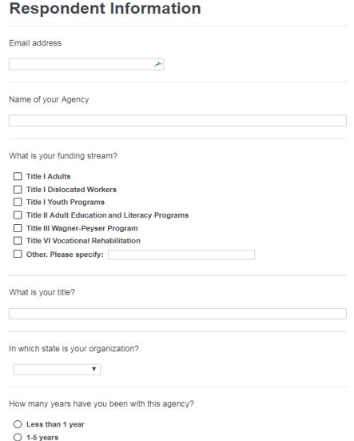
Online Self-Assessment Screen Shots
 | This is my agency | Isolated | Communicating | Coordinating | Collaborating | Integrated | Not familiar with this
Title I Adults
Title I Dislocated Workers
Title I Youth Programs
Title II Adult Education and Literacy Programs
Title III Wagner-Peyser Program
Title IV Vocational Rehabilitation – General Agency
Title IV Vocational Rehabilitation – Blind Agency
Notes:
Meera

Slide 20
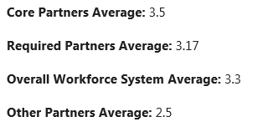
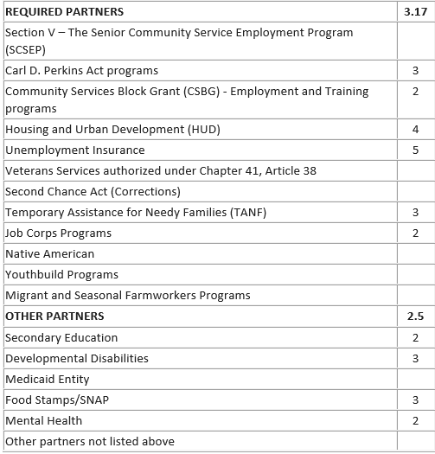
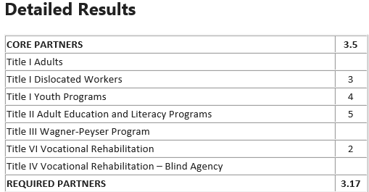
Summary of Responses
Notes:
Meera

Slide 21
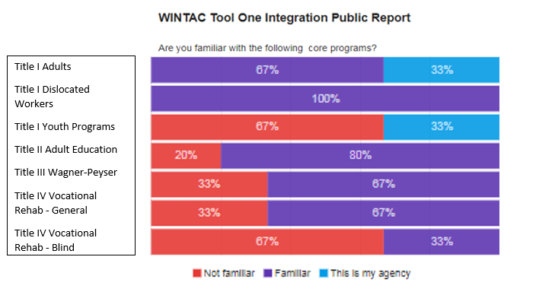
Aggregate of All Respondents
Notes:
Merra

Slide 22
Group Assessment and Planning Process
Assess the current level of engagement and connectivity between core, required and other American Job Center (AJC) partners on specific offerings and activities;
Join with staff and partners in discussions regarding the outcome of the assessment results;
Identify any local considerations and possible opportunities to strengthen or develop improved partnerships;
Assist teams with short- and long-term planning and establishment of ongoing evaluation for informing, shaping and measuring efforts/outcomes; and
Evaluate progress and provide a renewed focus.

Slide 23
Outreach and Intake
ISOLATION Each agency promotes services separately to community.
COMMUNICATION
Share written material between staff.
Share contact information of a representative from each agency.
COORDINATION
Develop joint brochure/flyer that identifies all partner agencies in the AJC and the services they provide.
Agency orientations and intake processes are separate but coordinated to maximize customer flow of service. This may include the timing, sequence of orientations and triage processes of customers being referred to other agency orientation and/or intake processes.
COLLABORATION
Partners establish a central contact point at the AJC that can connect customers to each of the separate partner agencies.
Together, the AJC agencies promote and host resource fairs in the community and participate in rapid response events for plant closings, and provide information regarding how to access each of the separate partner agencies.
INTEGRATION
Partners work together to establish outreach materials and resource fairs.
AJC services identified as functional as opposed to by agency.
Efforts to connect to community are planned strategically by teams representing the expertise of all partner service programs.
Notes:
Lou
These are generalized model and examples and not to be considered accurate for all AJCs. You may have different examples from your area or you may see some of the examples belonging in different columns – the most important thing is that the partners come to an understanding of where they are and discuss what if any movement they want to have along the continuum.

Slide 24
Assessments
ISOLATION Each agency has its own separate assessment process; does not regularly inform partners of assessment options.
COMMUNICATION
Inform partners of available assessments.
COORDINATION
Other partner staff may refer individuals with disabilities to the Vocational Rehabilitation program for specialized assessments and services.
COLLABORATION
Staff may meet cross-agency with the customer to go over assessment results with individuals who are co-enrolled in other services as with AJC, Special Education, etc.
INTEGRATION
Agencies participate in assessment strategies, tools and processes with co-enrolled consumers as a cross-agency assessment team for that consumer.
Notes:
Lou
Some states are comparing the rates they have from assessment providers to make sure they are paying the same amounts for the same assessments.
Some Adult Basic Ed programs have capacity to do more than they are now and some are at full capacity for testing.
VR often requires specific assessments but their clients can often benefit from standard assessments.

Slide 25
Career Services
ISOLATION Each agency has its own separate career service options; does not regularly inform partners of those services.
COMMUNICATION
Inform partners of available career services (resume workshops, etc.).
COORDINATION
Some individuals in VR-eligible individuals with disabilities receive career services for other AJC programs.
COLLABORATION
Staff may meet cross-agency with customer to develop their specific employment plans, including the utilization of career services within those plans for those individuals who are co-enrolled.
INTEGRATION
Core Programs work together to align services in their respective employment plans to better serve those individuals who are co-enrolled between agencies.
Notes:
Lou
Career Services. WIOA authorizes “career services” for adults and dislocated workers, rather than “core” and “intensive” services, as authorized by WIA. There are three types of “career services”
basic career services (examples)
Initial assessment of skill levels including literacy, numeracy, and English language proficiency, as well as aptitudes, abilities (including skills gaps),
Supportive service needs;
Labor exchange services,
Provision of referrals to and coordination of activities with other programs and services, including those within the one-stop delivery system
individualized career services,
Comprehensive and specialized assessments
Development of an individual employment plan
Career Planning
follow-up services.
These services can be provided in any order; there is no sequence requirement for these services. Career services under this approach provide local areas and service providers with flexibility to target services to the needs of the customer.

Slide 26
Case Management
ISOLATION Each agency operates its own separate case management system with no regular communication with other partners.
COMMUNICATION
Seek updates on status with other programs.
COORDINATION
Some staff share information about specific customers.
COLLABORATION
Staff may meet cross-agency with customer to provide joint case management services for those individuals who are co-enrolled.
INTEGRATION
Staff develop and utilize cross-agency case management practice as a normal practice for all those consumers who are co-enrolled.

Slide 27
Career Pathways
ISOLATION
No cohesive, integrated agency strategy for career pathways. Counselors are not coordinating career pathways goals. LMI or business engagement efforts are does not include individuals with disabilities.
COMMUNICATION
Cross agency, communication exists at the leadership level as it relates to development and updates of the WIOA State Plan. Counselors communicate with training entities and partners as it relates to funding and planning for skill and credential attainment only
COORDINATION
Staff are coordinating career fairs and efforts for business and sector outreach. Staff share information concerning plan progress about specific customers
COLLABORATION
Shared decision-making and accountability exists within leadership with procedures in place for all agency staff. Joint planning, resource leveraging and braided funding with clear plan coordination and role responsibility exists. Counselors partner through integrated resource teams and continuum of service delivery beyond VR exit is included.
INTEGRATION
Leadership vision and strategy is operational. All intake, evaluation assessment and plan development is conducted and implemented in a fully cohesive way inclusive of all relevant partners. All partners are invested in collective outcome and continuous improvement
Notes:
Lou

Slide 28
Business Services
ISOLATION Each placement specialist in each agency makes his/her own business connections; no sharing of business information between agencies beyond the information generated and entered into the Job Center’s search engine by the Wagner Peyser business representatives.
COMMUNICATION
Placement Specialists meet once a month for coffee and discuss business development strategies; partners share information on their programs, job fairs and similar events.
COORDINATION
Placement Specialists and Business Associates meet every Thursday at 3:30 P.M. and share the skill needs of their business contacts for the purpose of meeting the business needs and sharing placement opportunities.
Vocational Rehabilitation and Title I Adult Services coordinate outreach to Veterans with disabilities.
COLLABORATION
Business Service Specialists meet regularly and plan business events together, such as Job Fairs. They host a business event once a quarter to gain information on the needs of specific business sectors, and to provide information or training on topics identified as areas of interest by those business sectors. Partner agencies still approach businesses separately, but share information with each other to meet business needs.
INTEGRATION
Cross-Agency Business Services Team is created and sets the strategy for business engagement.

Slide 29
Meeting Agenda
Introductions
WIOA Vision: State, Regional and/or Local Objectives
Integration Continuum and Major Processes Examples
Integration Continuum Assessment (Small Groups)
Priority Areas Discussion (Small Groups)
Each group identifies 2-3 areas they would like to work on locally this year.
Each group identifies priority area activities for the coming year.
Priority Areas Report Out (Large Group)
Share their priority areas and proposed activities.
Consider regional goals.
Implementation Considerations (Small Groups)
Consider issues around capacity to accomplish your activities.
Identify areas where you will need assistance, and consider who might provide it.
Debrief and Next Steps
Notes:
Lou
WINTAC can provide the facilitation of a local convening of partners with the invitation of the state VR department.

Slide 30
Action Plans
Activities and Tactics: How will we do it?
Increase coordination and accessibility of Career Services with the intent to expand topic areas and attendance.
Greater cross-agency partnership and involvement with TANF as a mandated activity for customers to attend workshops.
Increase marketing of Career Services and workshops through Facebook and other social media and modalities.
Key Players: Who should be involved?
All partners.
To include possible partners not currently a part of the core group
VR Office Manager, DHS Manger, and Title I Manager
All partners.
Expected Outcomes:
What is the result?
Increased offering of workshops and increased attendance across partners.
Increase in use of Career Services as mandated activity of TANF recipients plan to increase successful employment outcomes
Increased offering of workshops and increased attendance across partners.
Timeline: When will we do it?
3 months
3-6 months
3-6 months
Questions and Assistance Needed
Need assistance and input from all partners at the front line and leadership for design.
Possible assistance from WINTAC
Greater coordination between One-Stop and TANF staff.
IT and other human resources. Greater coordination across partners and decision making on expanding reach to include other partners.
Notes:
As part of the onsite work we do, local AJC partners complete an initial action plan. WINTAC is available to support state level, regional and/or local follow up coaching and problem solving – including making connections with local efforts in other states.

Slide 31

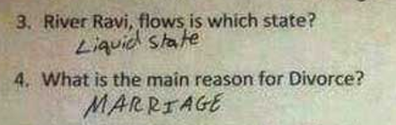
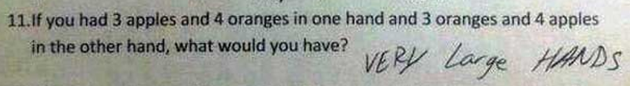
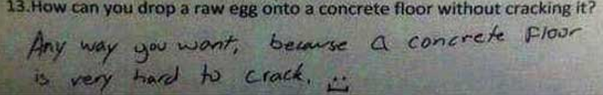
Questions and Answers
Notes:
Doug

Slide 32
For More Information
Lou Adams
Training and Technical Assistance Manager, National Disability Institute
Workforce Innovation Technical Assistance Center (WINTAC)
ladams@ndi-inc.org
www.wintac.org
www.realeconomicimpact.org
Doug Keast
WINTAC Project Director, National Disability Institute
Workforce Innovation Technical Assistance Center (WINTAC)
dkeast@ndi-inc.org
www.wintac.org
www.realeconomicimpact.org
Notes:
Doug

