Slide 1
Delaware Department of Labor
Division of Unemployment Insurance

Slide 2
http://ui.delawareworks.com/
UI Mission
To assist in the promotion of statewide economic stability and vitality by providing temporary, partial income maintenance to workers who become unemployed through no fault of their own, and by making referrals of unemployed workers to re-employment services.
Ensure adequate funding for the payment of unemployment benefits through the collection of employer taxes.
Contribute to the development of an adequate workforce by collecting a statewide training tax from employers to provide funds for the training of dislocated workers, school-to-work transition, industrial training and other training initiatives.
Notes:
UI takes over at this time.

Slide 3
A NEW CLAIM FOR UNEMPLOYMENT BENEFITS CAN BE FILED 1 of 2 WAYS: Via the Internet ~or~ In Person
Filing Via the Internet
Our site permits unemployed Delaware workers to file an initial or additional claim for unemployment insurance benefits via the Internet. (In state or out of state residency.)
The applicant must check off and agree to disclaimers while filing their claim, to prevent missed information, or directions, that could delay their claim. We ask that everyone please read these sections in their entirety and call if there are any questions. These are directions and guidance that would be provided in person if filing in one of our Local Offices.
The last page of the Internet application process will advise that their claim has been completed and will provide a confirmation number (if there are errors along the way they are highlighted). The claimant will then be directed automatically to the JobLink site to complete the required registration with the Division of Employment & Training.
http://ui.delawareworks.com/

Slide 4
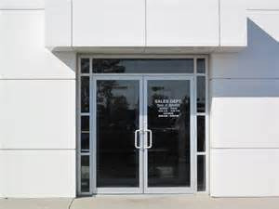
FILING IN PERSON
File for you Benefits in our Local Office that is closest to your home. Office hours are 8:00 – 4:00 M-F.
Bring the required documents with you for proper identification purposes (see page 4 of the Claimant UI Handbook).
UI Office Locations and Phone Numbers
Wilmington Local Office Dover Local Office
4425 North Market Street Blue Hen Corporate Center
Wilmington, DE 19802 655 S. Bay Road, Suite 2H
(302) 761-8446 Dover, DE 19901
(302) 739-5461
Newark Local Office Georgetown Local Office
225 Corporate Boulevard 20093 Office Circle
Suite 108 Unit 205
Newark, DE 19702 Georgetown, DE 19947
(302) 368-6600 (302) 856-5611
HOTLINE NUMBERS: (800) 794-3032 Kent & Sussex Counties (302) 761-6576 New Castle County

Slide 5
Are your wages in another State?
Contact your States Local UI Office:
State: Phone: Hours:
Maryland 410-334-6800 8:00AM - 3:00PM
New Jersey 888-795-6672 8:00AM - 4:00PM
Pennsylvania 888 313 7284 7:00AM - 5:00PM
Notes:
UI

Slide 6
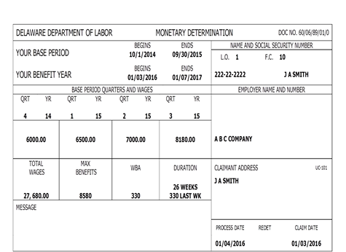
Within a few days of a new claim being filed a Monetary Determination is mailed to the claimant. This form shows information such as the claim date, base period wages, and how much the weekly benefit amount (WBA) will be if eligible.
The next process is the Claims Adjudication. A Claims Deputy reviews all cases that have separation issues (i.e. quits, terminations, etc.) to determine eligibility. Appeal Hearings are held with an Appeals Referee when the claimant or the employer do not agree with the Claims Deputy’s written determination.
Claimants that have valid recall dates, or are LOW, i.e. lack of work, business closures etc., generally do not have to go through a full adjudication process.
All claimants that have indicated medical issues, school or training, or those receiving pensions or severances must be adjudicated.

Slide 7
WAITING WEEK
A one week Waiting Period must be served in each claim benefit year before UI benefits can be paid. The claimant must properly file for the one week waiting period, meet all of the eligibility requirements for that week and not have excessive earnings for that week to be credited as the one week waiting period. Benefits are not paid for the one week waiting period.
Claimants should Not Wait to file for their weekly benefits request, and should start requesting their weekly benefits each week starting with the first week of their claim.
http://ui.delawareworks.com/

Slide 8
You can request your weekly benefits 1 of 2 ways: TELEBENEFITS File for your weekly benefits via the phone. The phone number for the information hotline is (800) 794 3032 in Kent and Sussex counties or out of state; or (302) 761 6576 in New Castle County. *You will create your own personal PIN the first time you call in. WEBBENEFITS File for your weekly benefits via the internet. Go to http://ui.delawareworks.com/ and choose WebBenefits to start your request. *Your PIN will be 9999 the first time you log on. You will be prompted to change this to your own personal PIN at that time.

Slide 9
YOUR WEEKLY BENEFITS ARE PAID 1 of 2 WAYS:
DIRECT DEPOSIT ~or~ DEBIT CARD
DIRECT DEPOSIT: Claimants can have their unemployment benefits deposited directly into their checking/savings account. Claimants sign up for Direct Deposit via the internet.
DEBIT CARD: Unemployment benefit payments can be directed to a Debit Card assigned through KeyBank. If a claimant does not sign up for Direct Deposit, their account will default to Debit Card.

Slide 10
What Responsibilities Do Claimants Have?
Apply for UI Benefits promptly when they become unemployed.
Register with DET and keep their JobLink account up to date.
Meet UI and DET work search requirements and be A&A.
Remain compliant with all UI and DET rules and regulations and respond to all contacts made by UI and DET timely.
Request benefits each week, starting with the 1st week (and choose Direct Deposit or Debit Card for receipt of UI benefits).
Ensure all questions are answered accurately. Gross earnings must be reported when “earned” not when received.
Always contact the Local UI office with any questions.
Watch the UI Informational Videos: Eligibility, Work Search, Reporting Earnings and Consequences of an Overpayment.
Notes:
In order to receive any of the services I’ve reviewed you need to register with us. It is easier then ever and you can register from your home computer. See this web-site listed on all of our slides (point to web-address). If you go there and click on “create a job seeker account” and follow the instructions. If you choose to register from home when you come to our office please let the front desk folks know that you have already registered from home. Also when given the option of either “self-service or “staff assisted” please choose STAFF ASSISTED. You can also register at any of our one-stops up and down the state, I believe many of you will utilize the (local office) one-stop.
If you have not already registered with UI we will direct you to there office as well. Please remember that you DO NOT have to collect UI in order to receive our services. You can come in tomorrow and start the process you don’t have to wait until your severance runs out.
Karen has already covered the work search requirement in detail.
Regular contact with your ESS. Again remember our mission, we want to get you back into the workforce as fast a possible. We don’t want your lifestyle, which I’m sure you all enjoy to be disrupted very much, so we want to help you find that job quick. In order to do that we are going to call you with job leads or ask you to come in for help with your resume and follow-up to that job interview. WE ARE HERE TO HELP YOU AND SO WE WANT TO KNOW HOW YOU ARE DOING.
If you are approved for training we want to hear from you even more. We want to know if you are showing up for class, how are your grades, are you happy with the classes, etc…….. I am sure all of you would like to know that your tax dollars are being spent wisely.

Slide 11
Eligibility Video Presentation
Followed by Questions & Answers
Notes:
To identify your nearest one-stop out of Delaware, you may search the “careeronestop” web-site.
Again, our web address and the jobline 800 number where you can listen to job openings throughout the state.

