Slide 1
Sustaining Continuous Improvement

Slide 2
Important Questions
Are you processes consistently effective?
Do your approaches address your organization’s needs?
How good are your results?
Is your organization learning, innovating, and improving?
“What got you here won’t get you there”

Slide 3
Steps to Maturity

Slide 4
What is Performance Excellence

Slide 5
Baldrige Impacts

Slide 6
Baldrige Program
Mission: To improve the competitiveness and performance of U.S. organizations for the benefit of all U.S. residents
Develops and disseminates Baldrige Framework
Manages the Malcolm Baldrige National Quality Award
Promotes performance excellence
Provides global leadership in the learning and sharing of successful strategies and performance practices, principles, and methodologies

Slide 7
Baldrige Community
Foundation for the
Malcolm Baldrige
National Quality Award
Department of Commerce
Board of
Overseers
Alliance for
Performance
Excellence
National
Institute of
Standards and
Technology
CV
Baldrige
Award
Recipients
ASQ
(Contractor)
Board of Examiners
Judges
Examiners
Cooperating Organizations
Professional Societies
Trade Associations

Slide 8
About MAAPE
One of 31 state and regional programs across the country.
Mission: To be the catalyst for performance excellence in all sectors of the tri-state economy.
501c(3) nonprofit corporation
No government funding
Pathway to the national program for organizations in PA, NJ, and DE

Slide 9
COMPONENTS OF THE BALDRIGE FRAMEWORK

Slide 10
Systems Perspective
managing all the parts of your organization as a unified whole to achieve your mission.
ensuring that your plans, processes, measures, and actions are consistent.
ensuring that the individual parts of your organization’s management system work together in a fully interconnected, unified, and mutually beneficial manner.

Slide 11
Baldrige Framework
Framework,
pg. 1
Notes:
This is the Baldrige Framework.
The Core Values and Concepts, which is the first component we’ll discuss, are positioned at the base of the Framework. That is to signify that the Core Values are the foundation of the entire Framework.

Slide 12
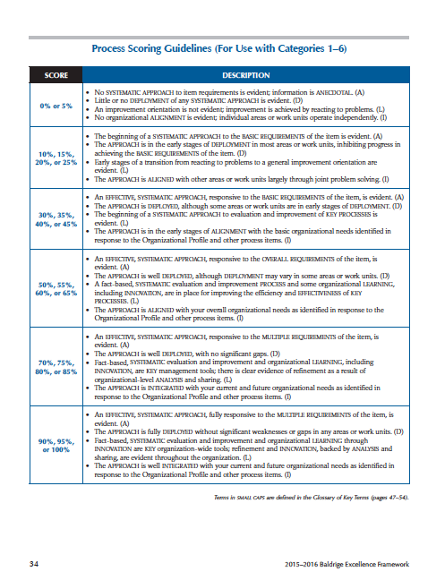
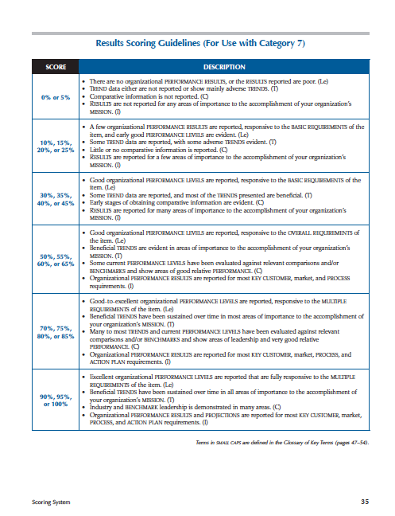
Components of the Framework
Core Values and Concepts
Criteria for Performance Excellence
Organizational Profile
Categories
Scoring System
PROCESS
RESULTS
Framework,
pg. 1 and pgs. 30 - 35
Notes:
[Review the information provided on the slide.]

Slide 13
Core Values and Concepts
Systems Perspective
Visionary Leadership
Customer-Focused Excellence
Valuing People
Organizational Learning and Agility
Focus on Success
Managing for Innovation
Management by Fact
Societal Responsibility
Ethics and Transparency
Delivering Value and Results
Slight differences across the three versions of the Framework reflect Sector differences
Framework,
pgs. 39 – 43
Notes:
These are the Core Values and Concepts from the Business / Nonprofit Framework.
There are slight differences in other versions, e.g., “customer-driven excellence“ is replaced by “student-centered excellence” in the Education Framework and “patient-focused excellence” in the Health Care version.
Also, in the Health Care version, “Societal Responsibility” is expanded to “Societal Responsibility and Community Health.”

Slide 14
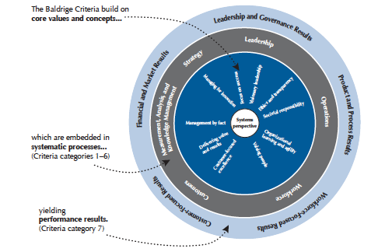
Core Values and Concepts
Framework,
pg. 41
Notes:
[Ask Examiners to turn to page 41 to see how Core Values are embedded in the Categories.]
This is the Business / Nonprofit version of this diagram.
If you’ll look at this chart on page 41 in your Framework booklet, you’ll see that the Core Values are aligned with the Process Categories in which they are most prominent. (They may also play a role in other Categories.)
Then, in turn, those processes are aligned with the related results.
So if an Applicant gets it right, the Core Values will flow through their key processes to their results.

Slide 15
Linkages
Key relationships within the Criteria and Application
Critical to alignment and integration
Three types:
Linkage between the Profile (Key Factors) and processes
Linkage between processes
Linkage between processes and results
Notes:
[This topic continues on the next slide.]
[This slide includes an automatic animation that will be activated when you show the slide.]
[This slide also includes a manual animation. CLICK as indicated below.]
[Review the first two bullets on the slide.]
[CLICK to review an additional bullet.]
[Review the additional bullet.]

Slide 16
Examples of Linkages
Organizational Profile
P.2a3 What key sources of comparative and competitive data are available … ?
Category 4
4.1a2 How do you select and effectively use key comparative data … ?
Category 7
All Items: How do these results compare … ?
Notes:
[This slide includes two manual animations. CLICK as indicated below.]
[The “Organizational Profile” box will appear on the slide when you show it. As you review the following points, CLICK to reveal the other two boxes when indicated.]
Here is an example of linkages in the Criteria:
It starts in the Organizational Profile, with the Applicant’s answer to “What key sources of comparative and competitive data are available?
[CLICK to reveal the second box.]
When you get to this question in 4.1, the answer to the question “How do you select and effectively use key comparative data?” should align with the answer to that question in the Organizational Profile (a Key Factor) and the information from the Profile should help you to evaluate their approach.
[CLICK to reveal the third box.]
When you get to Category 7 and are trying to understand the comparisons that are or are not provided for results, you should think back to what you learned about comparisons in the Organizational Profile and in Item 4.1.

Slide 17
Examples of Linkages
Organizational Profile
P.1b2 What are your key market segments, customer groups, and stakeholder groups …
Category 3
3.1a1 ... How do your listening methods vary for different customers, customer groups, or market segments?
Category 7
7.2a(1) … How do these results differ by product offerings, customer groups, and market segments … ?
Notes:
[This slide includes two manual animations. CLICK as indicated below.]
[The “Organizational Profile ” box will appear on the slide when you show it. As you review the following points, CLICK to reveal the other two boxes when indicated.]
Here is another, similar example:
We’re starting in the Organizational Profile again.
[CLICK to reveal the second box.]
What’s the relationship between this question from Category 3 and the one from the Profile?
The Profile questions ask what the segments and groups are, while Category 3 asks how your listening methods vary for those groups.
You need to know what the segments and groups are before you can evaluate how the Applicant tailors listening approaches for each one.
[CLICK to reveal the third box.]
What about this question in Category 7?
Again, the idea of groups and segments appears again; this time for results. The Applicants’ answers to the earlier questions should help you to evaluate how well the Applicant has segmented the results in 7.2a(1).

Slide 18
Examples of Linkages
Organizational Profile
Key Customer Groups/Segments
Organizational Profile
Key Customer Requirements
Category 3
Product Offerings (Requirements)
Category 6
Process Requirements and Measures
Category 7
Product and Process Outcomes
Notes:
[This slide includes four manual animations. CLICK as indicated below.]
[The “Key Customer Groups and Segments” box will appear on the slide when you show it. As you review the following points, click to reveal the other four boxes when indicated.]
This example is more complex, but when we break it down, you ‘ll see that the concept are the same:
It starts with understanding your key customers groups and segments.
[CLICK to reveal the second box.]
Then you determine customer requirements in Category 3 for these customer groups and segments.
[CLICK to reveal the third box.]
The requirements that result from that Category 3 process are listed in the Organizational Profile.
[CLICK to reveal the fourth box.]
They are also used to determine process requirements in Category 6.
[CLICK to reveal the fifth box.]
As Processes are better aligned with Customer Requirements, Product and Process Outcomes should improve.

Slide 19
Process (ADLI)
Approach: How do you accomplish your organization’s work? How effective are your key approaches?
Deployment: How consistently are your key approaches used in relevant parts of your organization?
Learning: How well have you evaluated and improved your key approaches? Have improvements been shared within your organization?
Integration: How do your approaches align to your current and future organizational needs?

Slide 20
Organizational Profile
There are two “Items” in the Profile:
P.1 Organizational Description
a. Organizational Environment
b. Organizational Relationships
P.2 Organizational Situation
a. Competitive Environment
b. Strategic Context
c. Performance Improvement System
Notes:
There are two “Items” in the Organizational Profile. (An “Item” is just a section of the Profile or a Category.)
The Organizational Description focuses on what’s important within the organization – the factors affecting the organization’s environment and its key stakeholders.
The Organizational Situation focuses on the external environment – competitive factors, what’s strategically important, and the performance improvement system.

Slide 21
Basic Information
Product and service offerings
Mission, Vision, and Values
Workforce Profile
Facilities, technologies & equipment
Regulatory requirements
Organizational Structure
Customers and stakeholders
Suppliers and partners
Competitive environment
Key strategic challenges and advantages

Slide 22
Criteria at a Glance
Leadership
How do your senior leaders lead the organization?
How do you govern your organization and fulfill your society responsibilities?
Strategy
How do you develop your strategy?
How do you implement your strategy?
Customers
How do you obtain information from your customers?
How do you engage customers by serving their needs and building relationships?

Slide 23
Criteria at a Glance
Measurement, Analysis and Knowledge Management
How do you measure, analyze and then improve organizational performance?
How do you manage your information and organizational knowledge assets?
Workforce
How do you build an effective and supportive workforce environment?
How do you engage your workforce to achieve a high-performance work environment?

Slide 24
Criteria at a Glance
Operations
How do you design, manage, and improve your key product and work processes?
How do you ensure effective management of your operations?

Slide 25
Outcomes (LeTCI)
Levels: What is your current performance?
Trends: Are the results improving, staying the same, or getting worse?
Comparisons: How does your performance compare with that of other organizations and competitors, or with benchmarks?
Integration: Are you tracking results that are important to your organization? Are you using the results in decision making?

Slide 26
Criteria at a Glance
Results
What are your product performance and process effectiveness results?
What are your customer-focused performance results?
What are your workforce-focused performance results?
What are your senior leadership and governance results?
What are your results for financial viability?

Slide 27
Delaware’s One-Stop Partner Programs
What if:
Each partner completed the Org Profile and shared it across the system?
Shifted thinking from vertical to horizontal?
Identified work systems in addition to work processes?
Identified and leveraged “Best Practices” across the network?
Looked for alignment and integration opportunities across the network
Shared client and referral information as appropriate?

Slide 28
Questions

