Slide 1
Application of Trauma Informed Care Approaches in Delaware:
Dept. of Services for Children, Youth and Their Families
&
Dept. of Education

Slide 2
State Services for Children in Delaware
Prevention
Summer & Afterschool Activities
Trauma Training in Community Programs
Early Identification
Youth Response Unit
Early Childhood Mental Health Consultants (ECMHCs)
Family Crisis Therapists (FCTs) - Elementary Schools
Behavioral Health Consultants (BHCs) - Middle Schools
Wellness Centers ~ Public Health - High Schools & some Elementary Schools
Handle with Care
Treatment
Building Community Supports
- EBPS
- Family and Youth Peer
- Wrap-Around Supports
Terry Center & Silver Lake

Slide 3

May 14, 2019
Take Care Delaware

Slide 4
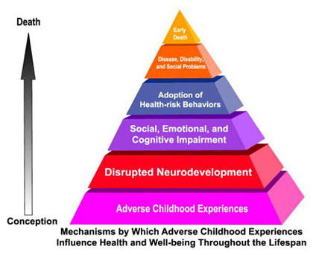
Adverse Childhood Experiences
The study demonstrated an association of adverse childhood experiences (ACEs) with health and social problems as an adult.
Among the approximately 17,000 adults surveyed, almost 2/3 of participants reported at least one ACE 1 out of 5 reported three or more
Notes:
Research shows that the prevalence of 10 specific ACEs—such as witnessing domestic violence or experiencing physical abuse—trigger a stress response that can harm a child’s developing brain. That stress and trauma weakens the immune system, increasing the risk of social, emotional, and health problems in later life, from suicide and substance abuse to diabetes, heart disease and cancer.
Back in the 1990s, Dr. Vincent Felitti, working with very obese adults, discovered that a shocking majority of his patients had suffered significant traumas during childhood. Eventually, his work led to a mega-study, involving tens of thousands of patients, which showed the long-lasting effects of “adverse childhood experiences,” or ACEs, such as child neglect or abuse, or a parent with addiction or imprisoned. Those children often grow up to be adults who are more likely to be sick, to be violent, to miss work, and to marry often.
ACEs trigger a stress response that can harm a child’s developing brain
THE PROBLEM: PREVALENCE OF TRAUMA
1. Many students have had traumatic experiences.
Studies now show that nearly every school has children who have been exposed to overwhelming experiences, such as witnessing violence between their caretakers, being the direct targets of abuse, and other kinds of adversity. The Adverse Childhood Experiences (ACE) study found higher levels of traumatic experiences in the general population than previously imagined. Among the approximately 17,000 adults surveyed, just over 50% reported having experienced at least one form of childhood adversity. These included physical, emotional or sexual abuse; witnessing their mother treated violently; having a parent with substance abuse or mental health issues; or, living in a household with an adult who had spent time in prison.
If we add those who are chronically bullied, experience periods of homelessness, live in the proximity of pervasive community violence, flee war-torn countries, undergo multiple invasive medical procedures, or live with a parent traumatized by recent combat, the number of children affected by significant adversity grows even larger.
Experts explain that trauma is not an event itself, but rather a response to one or more overwhelmingly stressful events where one’s ability to cope is dramatically undermined. These experiences in childhood can lead to a cascade of social, emotional and academic difficulties. As students get older, exposure to traumatic experiences can also lead to the adoption of self-medicating behaviors such as substance abuse, smoking, and overeating. All of these responses to traumatic events can interfere with a child’s ability to learn at school.
Childhood abuse, neglect, and exposure to other traumatic stressors which we term adverse childhood experiences(http://www.cdc.gov/violenceprevention/acestudy/prevalence.html) (ACE) are common. Almost two-thirds of our study participants reported at least one ACE, and more than one of five reported three or more ACE. The short- and long-term outcomes of these childhood exposures include a multitude of health and social problems.
The ACE Study uses the ACE Score, which is a total count of the number of ACEs reported by respondents. The ACE Score is used to assess the total amount of stress during childhood and has demonstrated that as the number of ACE increase, the risk for the following health problems increases in a strong and graded fashion:
Alcoholism and alcohol abuse
Chronic obstructive pulmonary disease (COPD)
Depression
Fetal death
Health-related quality of life
Illicit drug use
Ischemic heart disease (IHD)
Liver disease
Risk for intimate partner violence
Multiple sexual partners
Sexually transmitted diseases (STDs)
Smoking
Suicide attempts
Unintended pregnancies
Early initiation of smoking
Early initiation of sexual activity
Adolescent pregnancy

Slide 5
Neurobiological Effects of Trauma
Depression
Anxiety
Flashbacks
Disrupted neurodevelopment
Panic Reactions
Impaired memory
Difficulty controlling anger-rage
Dissociation
Health Risk Behaviors
Eating disorders
Smoking
Drug abuse
Physical inactivity
Suicide attempts
Self injury
Alcoholism
Multiple sex partners
Health Consequences
Diabetes
Chronic lung disease
HIV/AIDS
Heart Disease
Asthma
Cancer
Liver disease
STDs
Serious social problems
Homelessness, Prostitution, Inability to sustain employment, Delinquency, violence, and criminal behavior, Re-victimizations, Intergenerational transmission of abuse, Long term use of health, behavioral health, correctional and social services,
Compromised ability to parent
Notes:
Taken from Ann Jennings, Ph.D. “The ACE Study & Unaddressed Childhood Trauma

Slide 6
Not unusual for a newborn in DE to have 4 ACE’s
1. They live in a home with substance abuse.
2. Which increases their risk of maltreatment
3. Domestic violence and substance
abuse often go hand in hand
4. A parent incarcerated

Slide 7
Examples of Trauma
Abandonment/neglect, death or loss of a caregiver, automobile or other serious accidents, living in chaotic environments with inconsistent financial or housing resources, witnessing or suffering violence, bullying, physical or sexual abuse, neighborhood violence,
life-threatening illness/painful medical procedures, natural disasters, incarceration of a loved one, systems-induced trauma such as removal from home, multiple placements, separation from siblings, acts of terrorism

Slide 8

Trauma in Children
Turns off the learning switch!
Notes:
TRAUMA TURNS OFF THE LEARNING SWITCH
These experiences in childhood can lead to a cascade of social, emotional and academic difficulties.
As students get older, exposure to traumatic experiences can also lead to the adoption of self-medicating behaviors such as substance abuse, smoking, and overeating.
All of these responses to traumatic events can interfere with a child’s ability to learn at school.

Slide 9

Take Care Delaware
A program aimed at ensuring that children who are exposed to violence receive appropriate interventions so they can succeed in school to the best of their ability.
Research shows that trauma can undermine children’s ability to learn, form relationships and function appropriately in the classroom.
FOCUS BEHAVE APPROPRIATELY LEARN

Slide 10
The Problem
A recent national survey found that 60% of American children have been exposed to violence, crime, or abuse in their homes, schools or communities – and that 40% were direct victims of two or more violent acts.
Office of Juvenile Justice & Delinquency Prevention.2009. Children’s Exposure to Violence: A Comprehensive National Survey. http://www.ojp.usdoj.gov/ojjdp

Slide 11
Take Care Delaware
*Kids being successful in school*
Kids at risk tend to:
Skip school
Use drugs
Become violent
Commit crimes
End up meeting Law Enforcement
TCD intervention:
LE identifies children at the scene
The school is notified before school starts the next day.
We all handle the child with care and respond in a trauma sensitive way.

Slide 12

Take Care Delaware
TCD Notice from LE
Trauma sensitive schools
Therapy services on site
Notes:
Law enforcement just send it. If not, you are just going to be back in 2 days and Johnny is going to be a little hot mess!

Slide 13
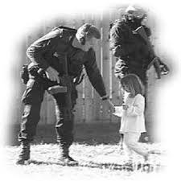
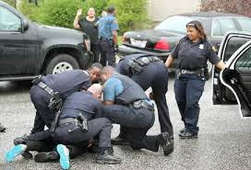

Who gets a TCD notice?
A child exposed to crime, violence or abuse.
If you have to ask “Should I send a TCD notice?” then you need to send one.

Slide 14
Examples of TCD notifications
Arrest of household member
Search warrant served in residence
Drug/alcohol overdose of family member
Death/Suicide of family member
Incident of domestic violence
Physical/sexual abuse
Community violence
Forced displacement from residence
House fires

Slide 15




Law Enforcement sending the TCD Notice to the School
It needs to be at the school
at the start of the school day!
Notes:
Every county is different and you need to decide what works best with the resources you have. Here are some suggestions.

Slide 16

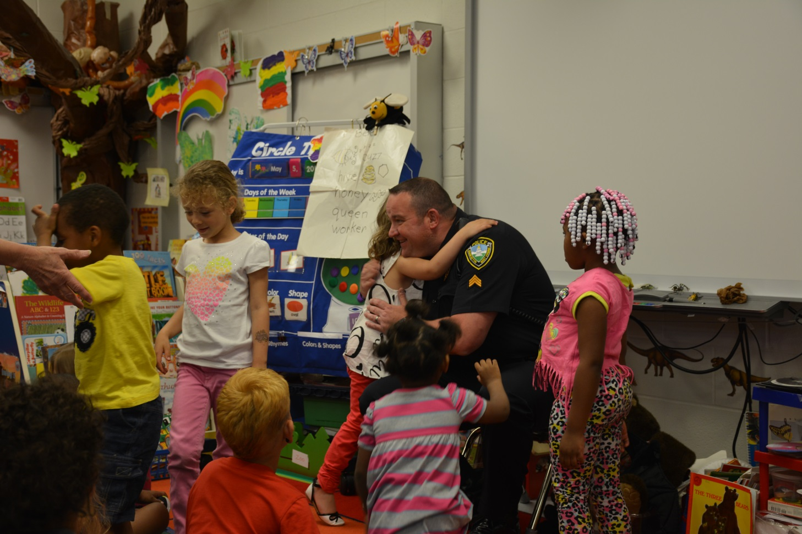
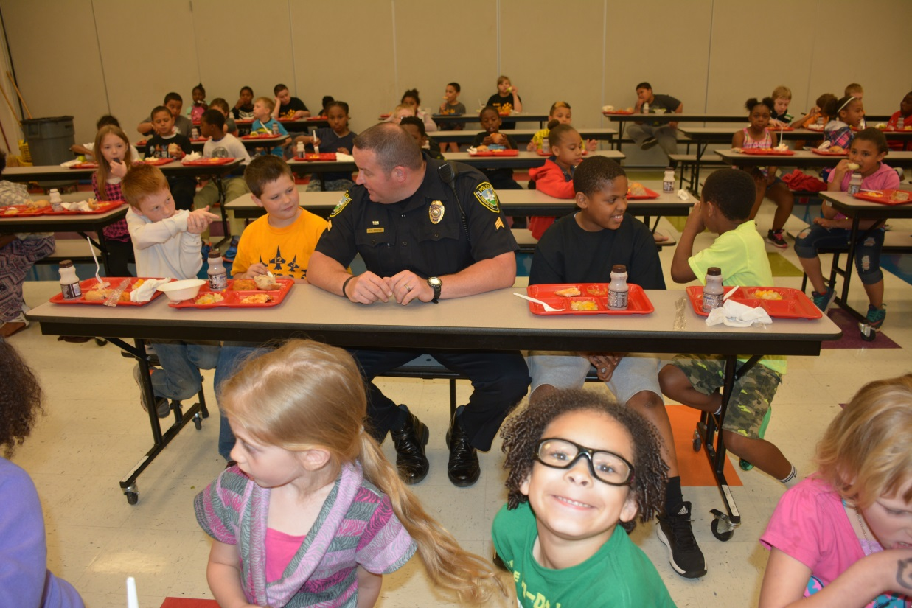
Building Relationships
Notes:
Pick one day a week and have a school lunch. Pick a school who doesn’t have a resource officer.

Slide 17
This Simple TCD Notice
Provides Law Enforcement with the ability to alert the school that this child was involved in a police incident last night and may have academic or behavioral problems today
No details are given
Just 3 simple words
Take Care Delaware
Notes:
You have to put someone in charge of the program who cares.
If the notice interrupts their lunch and that is an issue, odds are they should not be in charge
You can’t teach passion

Slide 18
TCD Notice
It arrives at the school before the start of the next school day.
Need to know basis only
Does not stay in child’s permanent record
School Internal TCD’s are very beneficial
It does not mean you approach the child

Slide 19

The Solution
A Trauma Sensitive School
A respectful and safe environment where children can build positive relationships with adults and peers, learn to manage their emotions and behavioral responses, and find academic success.

Slide 20
Children who are Traumatized
Diminished concentration, difficulty processing information, and problems with memory
Often have inappropriate behavior
Resulting In
Low achievement test scores
Poor work habits
Poor attendance
2.5 times more likely to fail a grade
Notes:
Children who have been exposed to trauma use a great deal of energy responding to, coping with, and resolving trauma
This may reduce their capacity to explore the environment and to master age-appropriate developmental tasks
Diminished concentration, memory, and the organization of language (Streeck-Fisher and van der Kolk, 2000; Beers and De Bellis, 2002; Nelson and Carver, 1998)
Inappropriate behavior and learning problems (McFalane et al., 2003; Shields & Cicchetti, 1998)
Perfectionism, depression, anxiety, and self-destructive, even suicidal, behavior (Shonk & Cicchetti, 2001)

Slide 21

*No one-size fits all approach
A School wide Approach to
Trauma-Sensitive Supports
Benefits all children whether or not we know they are traumatized
Involves the whole school staff
Provides teachers with the supports they need to address trauma’s impact on learning
Looks at child’s behavior from a different perspective
Notes:
Trauma-Sensitive Schools Environments Benefit all Children: Those whose trauma history is known, those whose trauma will never be clearly identified, those who may be impacted by their traumatized classmates.
Includes all staff from Principles, counselors, teachers, aids, cooks, custodians, bus drivers.
Educators sometimes see a misbehaving child as a bad kid or a mean or oppositional kid, when they might just be a scared kid. The child’s behavior is the result of chronic exposure to traumatic events beyond this or her control.
Apart from employing a mindfulness curricula, or classroom yoga practices, which also are gaining popularity, simply greeting students at the start of the day and “acknowledging their humanity” before diving into tasks will help, Moreno says. With all the demands placed on teachers, it can be difficult, even “radical,” for teachers to slow down the pace of their classes and to take time with every student, but it will pay dividends, she says.

Slide 22
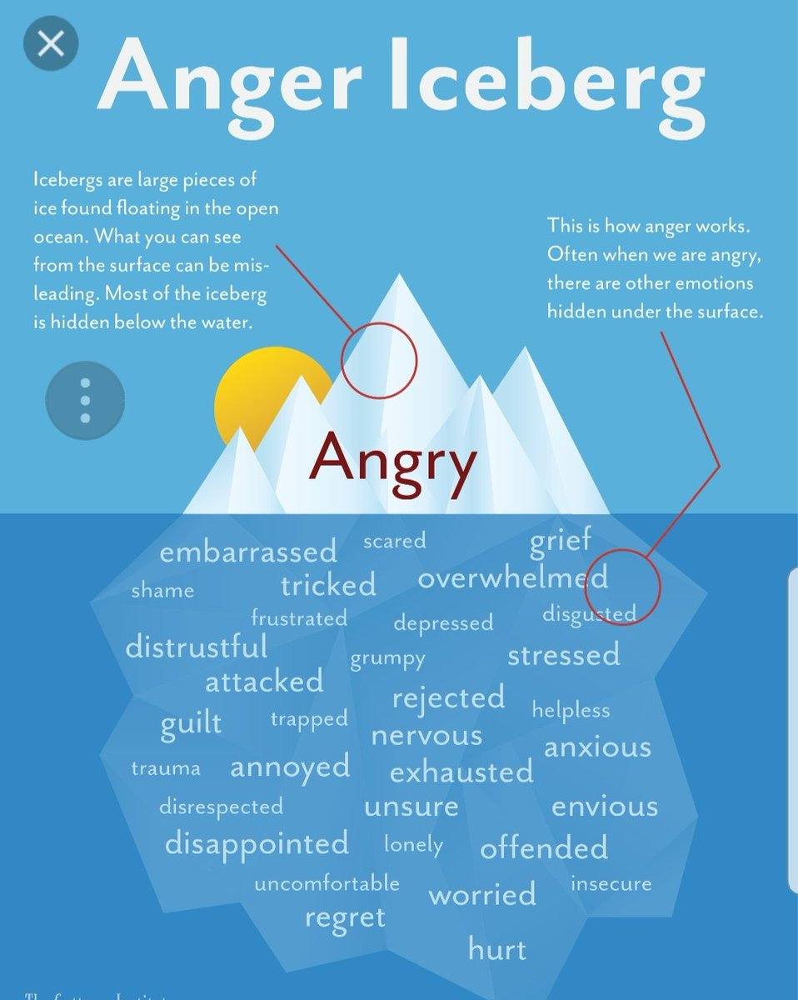

Slide 23
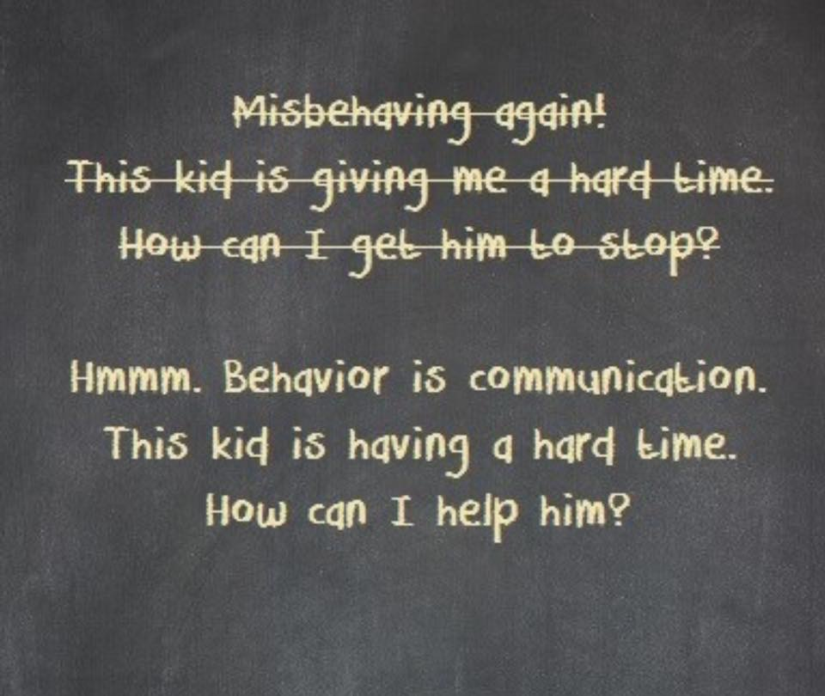

Slide 24
Notes:
Ofte.n school is the safest place a child has so it can’t resemble a battle ground

Slide 25

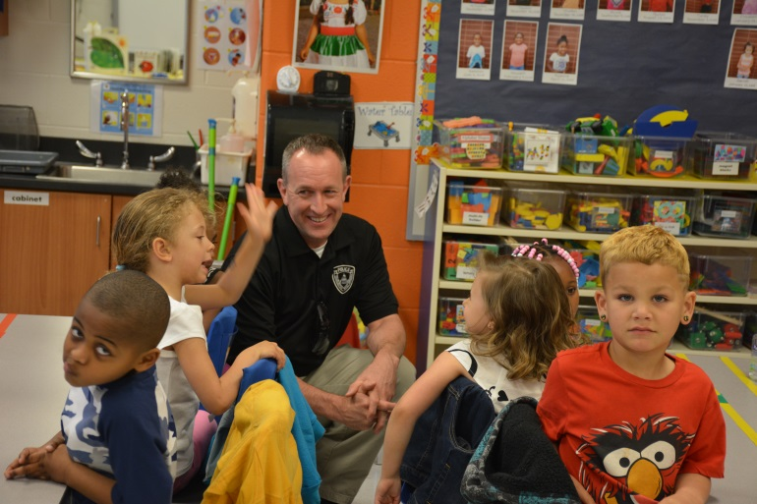

School Interventions
Thumbs Up
LE visiting classroom
Therapy Dogs
Notes:
Thumbs up
Mentors
Therapy Dogs
LE Officers visiting school
Fostering closer relationships
Classroom interventions

Slide 26

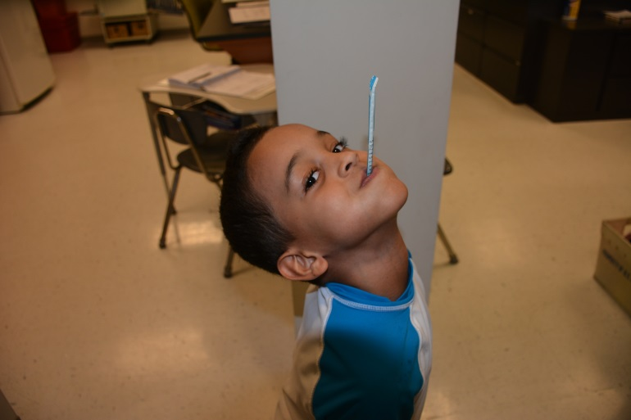
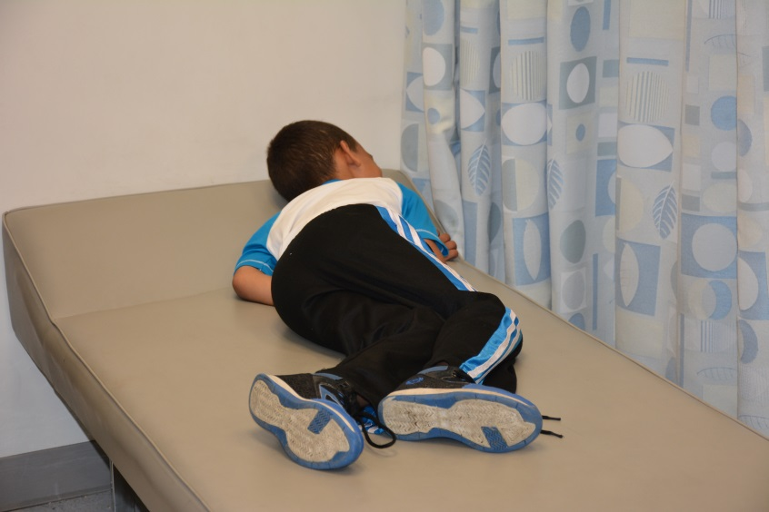
Individual Academic Interventions
Postpone
testing
Rest
Retesting
IEP
Notes:
Rest
Retest
Postpone testing
IEP

Slide 27


Individual Behavioral Interventions
Notes:
Get Ready Rooms
Send to counselor instead of principal
Acknowledge behaviors and teaching appropriate forms of expressions
Relaxation therapy (deep breathing)

Slide 28
School Response without
TCD Intervention
Comes to school without homework
  Naturally he got a zero
Fell asleep in class
  Lost his recess
Got into a scuffle at lunch
  Received detention
Didn’t bring permission flip for field trip
  Had to stay back and read in the library
Notes:
Johnny is in the 5th grade and typically comes to school a little disheveled and has trouble paying attention in class. With little redirection he gets by.
Johnny had a bad day that will likely continue to snowball due to a drop in grades, teacher perception and Johnny’s experience with school.

Slide 29
School Response with
TCD Intervention
Comes to school without homework
  Math teacher gave extra time to do homework and offered 1:1 help if he needed it
Fell asleep in class
  Sent to the school nurse to get some rest
Got into a scuffle at lunch
  There was no scuffle because he was rested and supported throughout the morning. He had a good lunch with no issues
Didn’t bring permission slip for field trip
  Homeroom teacher made a phone call to his family and got verbal permission over the phone
Notes:
Johnny is in the 5th grade and typically comes to school a little disheveled and has trouble paying attention in class. With little redirection he gets by.
First thing in the morning, the school received an email from the local police department that simply stated “Handle Johnny Doe with Care”
His teachers were made award that something happened in Johnny’s home last night that involved Law Enforcement. They knew he might not be himself that today.
The guidance counselor made it a point to say hello and welcome him to school and reminded him that she is always there if he needs anything
Johnny’s day was pretty good.

Slide 30

Take Care Delaware
Does not excuse bad behavior
Children are still accountable for their actions
TCD seeks to provide students with tools and skills to appropriately respond in an acceptable manner
Notes:
A trauma-informed model builds positive caring adult relationships through holding kids. . ACCOUNTABILITY. . . (In school suspension vs. out of school suspension)

Slide 31

TCD In Summary
Identifies the kids most at risk
Provides teachers with a heads up
Connects children with accessible mental health services if needed
Strengthens and improves relationships in the community.

Slide 32
Let’s Make Take Care Delaware Successful in Our Community!
QUESTIONS?
Patricia Chapman
(302)892-6422
Patricia.Chapman@delaware.gov
TCD Coordinator

Slide 33
Creating Success with
Whole Child Learning
Teri Lawler, MA
Education Associate, TIP-SEL
Delaware Dept. of Education

Slide 34
Trauma and Toxic Stress
  Childhood trauma and toxic stress are a national health crisis that impedes brain development, leaving children emotionally dysregulated and unable to learn.
Notes:
Julius
Acute trauma – sudden, particular time and place, short-lived
Chronic Trauma
Exposure to trauma can occur repeatedly over long periods of time. These experiences call forth a range of responses, including intense feelings of fear, loss of trust in others, decreased sense of personal safety, guilt, and shame. We call these kinds of trauma chronic traumatic situations.
Complex Trauma
exposure to multiple or prolonged traumatic events and the impact of this exposure on their development
Vicarious Trauma
empathic engagement with traumatized clients and their reports of traumatic experiences. Its hallmark is disrupted spirituality, or a disruption in the trauma workers' perceived meaning and hope.
Call out examples of Trauma
•Community Violence
•Domestic Violence
•Medical Trauma
•Natural Disasters
•Neglect
•Physical Abuse
•Refugee Trauma
•School Violence
•Sexual Abuse
•Terrorism

Slide 35
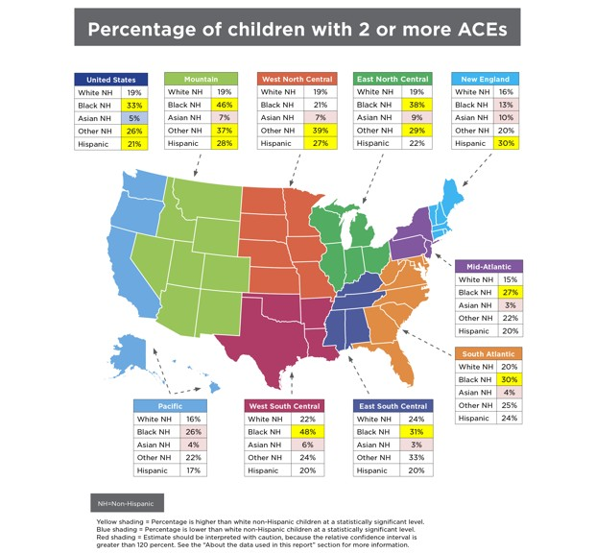

Slide 36

Notes:
One of the goals that grew out of our Change in Mind theory of change was to become champions for the science in our community - to advocate for brain-science informed policies and practices not only in our own agency, but also out in our community. We began training anyone who would listen about the impact of toxic stress on the developing brains and bodies of children - and the impact that has an adults and communities. We became very involved in our state’s grassroots organization -- called Trauma Matters Delaware - working with them to think beyond “trauma” and embed the brain science of toxic stress AND resilience in our community-focused work.

Slide 37

Compassionate Schools Start-Up Guide:
Mapping the Journey
Notes:
This is NOT one size fits all. Use what makes sense and works for your context.
These are not turn-by-turn directions!

Slide 38
Rodel Teacher Council
Celebrate and highlight something your state has done. You can use more than one slide for this.
Accomplishments/updates can include multiple things around any of your goals or can be about one specific thing (district-state partnerships):
competencies/frameworks
Guidance
Professional learning
Supporting/ connecting with districts
Assessment
Equity
Alignment with other Frameworks (MTSS, PBIS, Trauma-Informed)
Academic Integration
Adult SEL
Quick snap shot of what your aims and objectives have been and where you plan to go
Landscape analysis completed with the support of the Rodel Foundation’s Teacher Council. Grassroots effort comprised of public – private partners representing the education, youth-serving, and philanthropic communities. Core team and cross sector steering committees meet monthly for problem solving and planning in consultation with CASEL national advisor. Alignment with other state priorities to enhance the MTSS framework, expand universal supports for academics and behavior, reduce barriers to learning for all students. DOE dedicated a position to building statewide capacity for trauma informed practices and social emotional learning in November 2018.

Slide 39

Delaware by the Numbers
Population | 961,939
Size | 1,981 square miles
Counties | 3
School Enrollment | 139,144 students
School Districts | 19, plus 23 charter schools

Slide 40
Compassionate Schools Learning Collaborative
1
Training
2
3
Systems Improvements
Strategic Implementation
Trained more than 7,500 educators and connected professionals
Developed Compassionate Schools Start-Up Guide
Developing Train the Trainer approach for broader dissemination & sustainability
Developed Test Lab for educators to try hands-on strategies and tools in classrooms
Compassionate Connections project embedded brain-science informed approaches in five schools with rigorous evaluation component to identify opportunities for systems improvements
Built & leveraged relationships with DSEA, DDOE, Governor & First Lady
Establishment of Office of Innovation and Improvement at DOE
Reinstatement of Governor’s Family Services Cabinet Council
Executive Order #24 making Delaware a Trauma-Informed State
Notes:
Trainings:
Toxic Stress & the Impact on Learning
Strategies to Help Students Build Resilience
Self-Care for Educators
Early data is promising -- reductions in suspensions for kids in foster care, increased use of alternatives to suspensions, descreases in behavioral referrals

Slide 41
Myths about Trauma Informed Approaches in Education
We have received training! We are trauma informed!
Training is critical but it’s not enough.
This is just one more thing for teachers to do. Teachers ARE asked to fulfill many roles beyond instruction. This is a shift in mindset more than something to do.
We can’t afford a therapist/nurse so we can’t serve our students with trauma. Supports in schools are helpful, but these resources are not required.
Trauma-informed approaches are just about students. The health and well-being of staff is essential.
Notes:
Training is critical! But to become truly brain-science informed, we need to use a universal approach that address practic, policy, resources, and culture
Teachers are asked to fulfill many roles beyond instruction. To become brain-science informed, we need to build buy-in from all staff in a building -- from teachers to cafeteria workers to bus drivers. The focus on toxic stress & resilience should become the foundation for practices, replacing strategies that don’t serve the needs of students.
With the buy-in of leadership and staff, it is possible to create a fully-functioning team to address needs of staff and students.
Without an intentional focus on staff well-being, these efforts will face major barriers.

Slide 42
What Does a Trauma-Informed School Look Like?
1
Aware
Sensitive
Responsive
2
3
4
Informed
School staff have been informed about the science of toxic stress and resilience and have begun to think about how to use this info to support changes within the school.
School staff begin to explore brain-science principles and how they apply to existing practices. There is leadership buy-in for a change process. Brain-Science Core Team is established. Schools share with community and stakeholders that they have begun this journey.
Schools begin to change practices/policies and implement new ones to better support staff & students. Schools start to integrate brain-science approach throughout all programs. Individual staff members begin to demonstrate changes in actions. Community is bought in.
Schools begin to see results from changes they have implemented. All staff are bought in, demonstrating practices that reflect the needs of students. Data drives decision-making. Schools work closely & responsively with parents and community members to meet ongoing needs.
Notes:
Trainings:
Toxic Stress & the Impact on Learning
Strategies to Help Students Build Resilience
Self-Care for Educators

Slide 43

Step 6c: Make Changes
Notes:
CHANGE IS HARD
CHANGE TAKES TIME
CHANGE TAKES PRACTICE
CHANGE TAKES ATTENTION

Slide 44
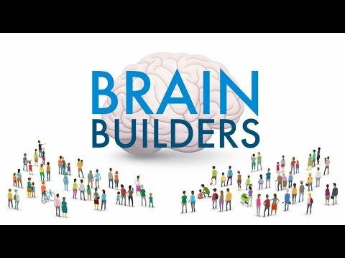

Build Stronger Brains and Resilient Communities
Experiences Build Brain Architecture
Serve & Return Interaction Shapes Brain Circuitry
Toxic Stress Derails Healthy Development
Notes:
Trauma affects the brain, especially the developing brain. This three-part video series from the Harvard University Center on the Developing Child and the National Scientific Council on the Developing Child depicts how advances in neuroscience, molecular biology, and genomics now give us a much better understanding of how early experiences are built into our bodies and brains.
The playlist containing all three videos is available at http://www.youtube.com/playlist?list=PL0DB506DEF92B6347.

Slide 45
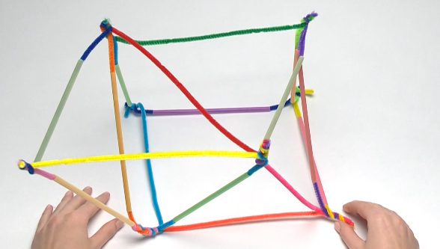
Compassionate Schools Curriculum:
Brain Architecture Game
Developed by Harvard Center on the Developing Child
Hands-on, experiential learning
Team-building
Introduction to concepts of toxic stress and brain architecture
https://dev.thebrainarchitecturegame.com/get-a-copy/
Notes:
Highly recommend this activity – at CFF, have played with staff, Board, foster parents – on other places, folks have even played with legislators, policy makers
The brain architecture game helps people appreciate the impact of early childhood experiences on outcomes across the lifespan.
“It wasn’t a fair game,” said one legislator after watching his brain collapse. “I got a lot of unlucky cards.”
“Isn’t that the way it happens in real life?” replied the game facilitator.
Really great introduction to concepts around toxic stress and brain development using real-life examples
BRING SOME SUPPLIES

Slide 46
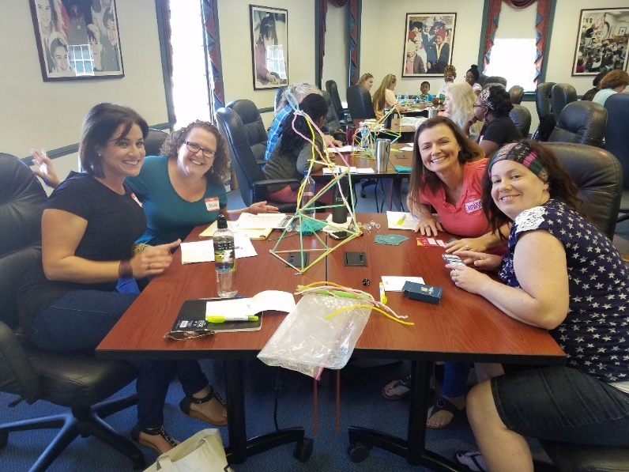
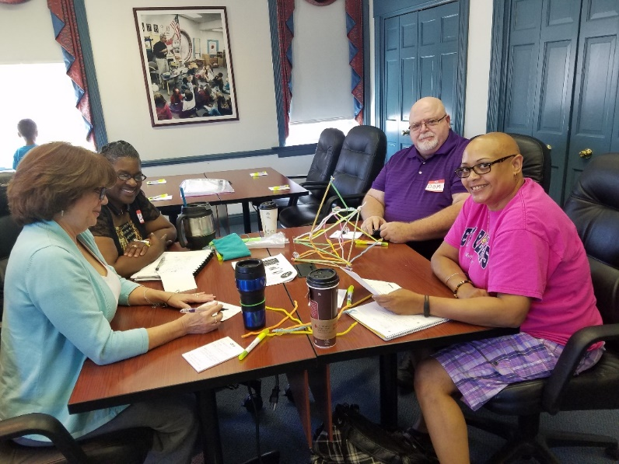
Building Brains is Group Work!

Slide 47
Building Relationships and Targeted Skills
STUDENTS
STAFF
CURRICULUM

Slide 48

Curriculum: Educator Self-Care
Preventing staff burnout
Understanding impact of vicarious
trauma
Strategies for developing self-care
practice
Hands on tips & tools
Increases staff retention
Contributes to perceived organizational support
Notes:
Part of the culture of compassionate schools – trauma impacts everyone
Vicarious trauma can result in burnout
Schools need to improve culture of self-care

Slide 49

Professional Learning Strategy
Notes:
We’ve developed a set of offerings that schools can do all or part of – trying to align with PD schedules is a challenge!
We are also working to increase our cadre of trainers in order to more broadly disseminate content
We’ve delivered content to more than 1,500 educators across the state

Slide 50

Build Capacity in Schoolwide Systems
Presentations
Professional Learning Communities
Book Studies
Student Support Coaching
Peer Buddies
Co-Teaching
Universal Screening

Slide 51
Book Study
Heart of Teaching & Learning (Hertel, Wolpow, Johnson, Kincaid)
Lost at School (Greene)
The Boy who was Raised as a Dog (Perry)
Fostering Resilient Learners: Strategies for Creating a Trauma-Sensitive Classroom (Souers & Hall)
The Body Keeps the Score(Van Der Kolk)

Slide 52

Strategies to Build Resilience

Slide 53

Step 1: Build Your Team
Assemble a team of committed leaders from across your school or system
Visionary - Task-Oriented
Cheerleaders - Naysayers
Academics - Supports
Administrator - Direct Staff
Students- Parents
Notes:
This team is going to be critical. You need a BROAD spectrum of members to make this work.
Our experience has shown that buy-in from ADMINISTRATORS is KEY. They have to be part of the team and commit the time and resources to the effort.

Slide 54

Step 2: Understand the WHY
and Set Your Intention
Why are you embarking on this journey? Do you believe that schools are positioned to meet the needs of students who have experienced adversity? What do you hope to accomplish?
Create a mission or vision statement, or tagline….or haiku to describe your intention
“Trauma impacts brains.
But together, we can build
resilient students.”
Notes:
If this journey works, what will look different? How will we know?
This is your GOAL Statement.

Slide 55
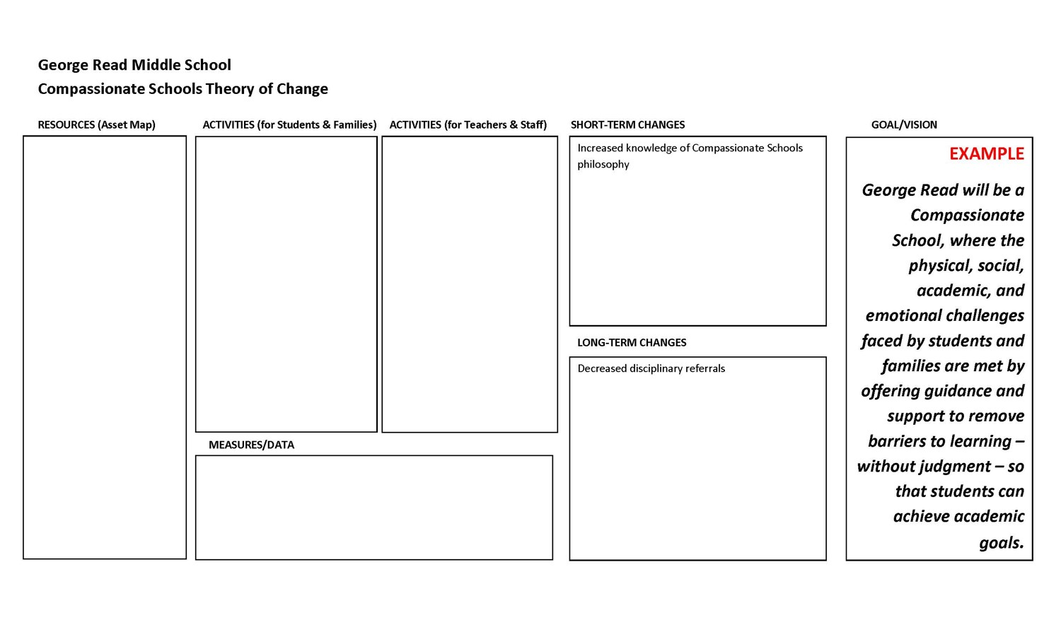
Create a Theory of Change
Background: Students across Alberta experience toxic stress. The science tells us exposure to adversity impacts learning, behavior, and health. Schools are well-positioned to meet this challenge with brain-science-informed approaches.
short-term
longer-term
Truama Support Team
Baseline assessment of current practices
Training
Active Parent Group
$ for student support needs
Trauma groups for students
Train all staff
One Book - One School
Host Resilience screening for staff & families
“Connect the Dots”
Work with school board to modify school discipline policies
Develop building-level coaching model to support brain-science informed classroom strategies
Increased awareness of trauma informed practices among students, staff, and families
Increased use of trauma- aware classroom strategies
With a deeply rooted understanding of trauma and a commitment to using related innovative approaches, this school will support students, staff, and families to reach their full potential.
Improved results on assessment of practices
Improved school climate
Improved attendance
Improved staff satisfaction & retention
Improved parent engagement
Lesley Trauma Sensitive School Checklist
School climate data
Behavior data
Notes:
I’ve tricked you into creating a theory of change!! You now have all the pieces you need to create a logic map or theory of change.
This is a living document -- don’t create it and then bury it. Revisit it at every meeting of your Brain Science Team. Make adjustments. Add and subtract.

Slide 56

Step 3: Create an Asset Map
What resources already exist in your school that you could leverage to support your efforts?
Behavioral support staff or programs
Student activities
Professional development resources
Where are the gaps? Can you develop partnerships to meet them?
INDIV. SUPPORTS
TARGETED INTERVENTIONS
UNIVERSAL or
PREVENTION
Notes:
BRAINSTORM
Identify all resources, processes, and systems that are in use in your school or district.
What interventions are in place to support students? Families? Staff?
Create a master list. Think about organizing according to level of impact -- level 1 might be prevention resources that are available to all students. Level two might be interventions targeted towards kids with similar deficits - like a

Slide 57
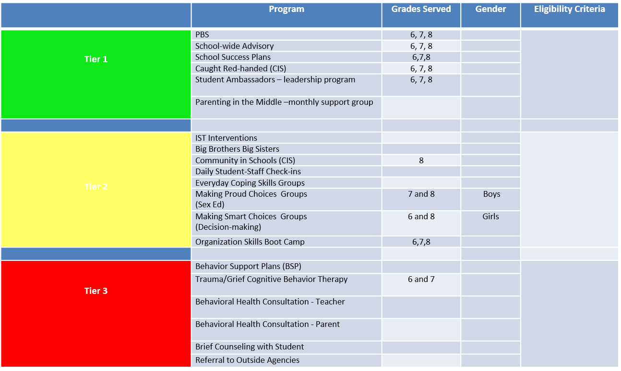
Step 3: Create an Asset Map
Universal
Prevention and Promotion
Targeted Interventions
Individualized Supports
Notes:
BRAINSTORM
Identify all resources, processes, and systems that are in use in your school or district.
What interventions are in place to support students? Families? Staff?
Create a master list. Think about organizing according to level of impact -- level 1 might be prevention resources that are available to all students. Level two might be interventions targeted towards kids with similar deficits - like a

Slide 58
Realign Service Delivery Model to Enhance System of Care
Trauma-Informed Schools Framework PD
Grade Level Advisories
Tier 1/Universal
School-Wide Assessment
School-Wide Prevention Systems
Success Plans
Daily Progress Report
Soar Snippets
Character
Education
Caught Red-handed
Collaborative Problem Solving
ODRs,
Attendance,
Tardies, Grades,
DIBELS, etc.
Parenting in the Middle
Tier 2/
Secondary
Tier 3/
Tertiary
Student Support Coaching
Social/Academic Instructional Groups
Making Proud Choices Group
Assessment
Intervention
Group Check-in/ Check-out
Daily Progress
Report (DPR)
Behavior and
Academic Goals
Everyday Coping Skills Group
Making Smart Choices Group
Developmental Discipline
Individualized Check-In/Check-Out, Groups & Mentoring (ex. CnC)
Trauma/Grief CBT
Organization Skills Boot Camp
Prevent - Teach – Reinforce (PTR)
Competing Behavior
Pathway, Functional
Assessment Interview
Brief Functional Behavioral Assessment/
Behavior Intervention Planning (FBA/BIP)
4 Pillars Groups
Complex FBA/BIP
Brief Counseling with Individual Students and Small Groups
Wraparound
Behavioral Health Consultations
Referral to Outside Agency
Adapted from Illinois PBIS Network, Revised May 2009
Notes:
Black = school-wide systems of support
Red = small group and individualized systems of support

Slide 59

Step 4: Evaluate Your Data
Where are your strengths? What needs additional attention?
Academic outcomes
Attendance
Behavior data
School climate
Parent engagement
Staff satisfaction & retention
Where are you hoping to move the needle?
Notes:
We collect a lot of data - and systems put a lot of pressure on achievement.
There are certain pieces of the data that we may look at frequently, and others, we collect but don’t use.
Take a scan of what you have. Use your committee to wrestle with what it means and what you think is important as you work to become brain science-informed.
Are there pieces of information that you don’t collect but you think could be helpful? Can you think of a way to collect it?

Slide 60

Step 5: Assess Your Practices
Where does your school or system fall on the continuum of brain-science informed approaches?
ARTIC ($) or TICOMETER ($)
  Assesses readiness for trauma-informed care implementation
Lesley Trauma-Sensitive School Checklist
  Free assessment designed specifically for schools
Notes:
Sample questions on next slide

Slide 61

Step 6: Create an Action Plan
What actions do you need to undertake to get to your end result? How will you engage your school community?
Build Awareness
Build Commitment
Make Changes
Measure Success
Notes:
BRAINSTORM
Identify all resources, processes, and systems that are in use in your school or district.
What interventions are in place to support students? Families? Staff?
Create a master list. Think about organizing according to level of impact -- level 1 might be prevention resources that are available to all students. Level two might be interventions targeted towards kids with similar deficits - like a

Slide 62

Step 6a: Build Awareness
How will you build awareness and understanding of trauma?
Professional Development:
Book Study Circles
Training for parents & students
  Brain Architecture Game
  Resilience Movie
Notes:
Professional development should include EVERYONE in the building -- we all need to speak the same language.
But this needs to be intentional and planned. We will get requests at the last minute -- basically filling time on someone’s PD calendar. Think about how you sustain this over time. Imagine you’ve trained everyone in the building on the science, but then three teachers leave. How do you bring new staff on Board? How can you include regular refershers? Can you create an internal training team?

Slide 63

Step 6b: Build Commitment
How can you support buy-in?
Commitment by leaders
Dedicating resources to the work
Supporting staff self-care
Engaging authentically with
students & families by seeking their input
Sharing results
Sustainability
Notes:
Staff self-care is absolutely key and could be a conference of its own. How can you support staff self-care? This needs to move beyond “Birthday Club” or a chair massage during teacher appreciation week.

Slide 64

Step 6c: Make Changes
What needs to change to get you to your goal?
Schoolwide policies and practices
Classroom approaches
Family engagement
Use of resources
Feedback loops
Notes:
You’ve reviewed your data, assessed your practices, mapped your resources, and set your intention.
Don’t try to swallow the ocean! In order to keep people engaged -- change should be manageable and visible! Think in categories - short term and longer term. What can you do now, and what will take more time?
Resist the urge to Slash and Burn. For example -- you may decide that your discipline policy is too harsh and does not align with the science. You’re tempted to eliminate it - and maybe that makes sense. But think through the unintended consequences. If you tell staff they can no longer give students out-of-school suspensions for certain behaviors, they need to have an alternate strategy to use. Maybe instead, you’re going to create a “Turnaround” room where students can connect with a behavioral health consultant, or practice mindfulness, or participate in restorative practice (once they are calm!).

Slide 65

Step 6d: Measure Success
How will you evaluate the impact of your work?
Reassessment using identified tools
Teacher, student, family surveys or focus groups
School climate surveys
Proxy data - behavior, attendance, etc.
Notes:
Professional development should include EVERYONE in the building -- we all need to speak the same language

Slide 66
Step 7: Sustainability
Stay focused! Keep at it!
Continue to revisit your Theory of Change - modify & update!
Figure out how to include new folks (staff, students, parents) in your work and vision.
Communicate with your stakeholders!
Failure is OK! Understand it and use it to improve.
Notes:
This is a marathon, not a sprint! And there is no real finish line to this race. Just a cycle of improvement,

Slide 67
Thank you for your attention!
Teri Lawler, MA
Education Associate
Trauma-Informed Practices and Social and Emotional Learning
teri.lawler@doe.k12.de.us
302-857-3306

